Slide 1




Search for resonant double Higgs production with bbZZ decays in the bbllνν final state
Ph.D. defense (16 July 2019)
Rami Kamalieddin (UNLHEP)
Advisor: Professor Ilya Kravchenko

Slide 2
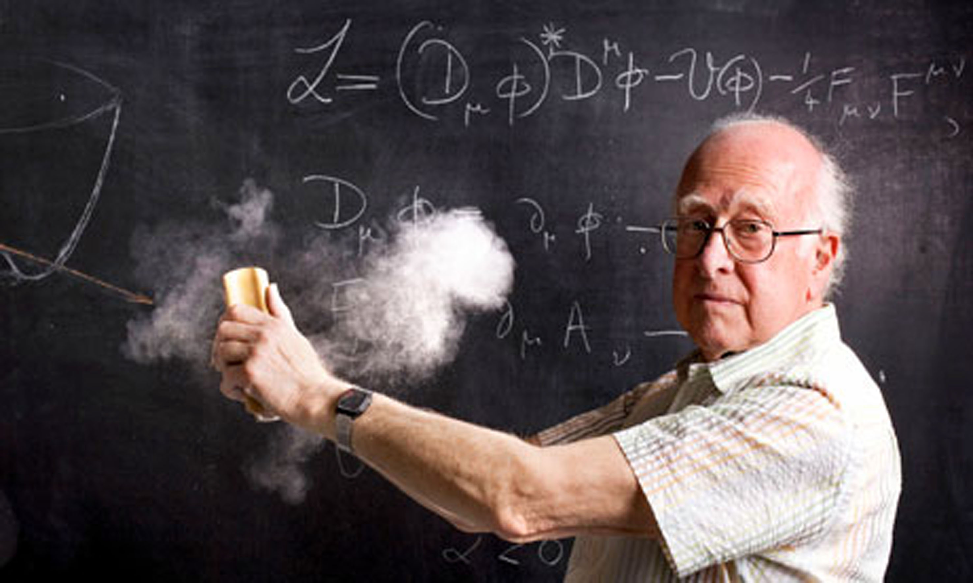
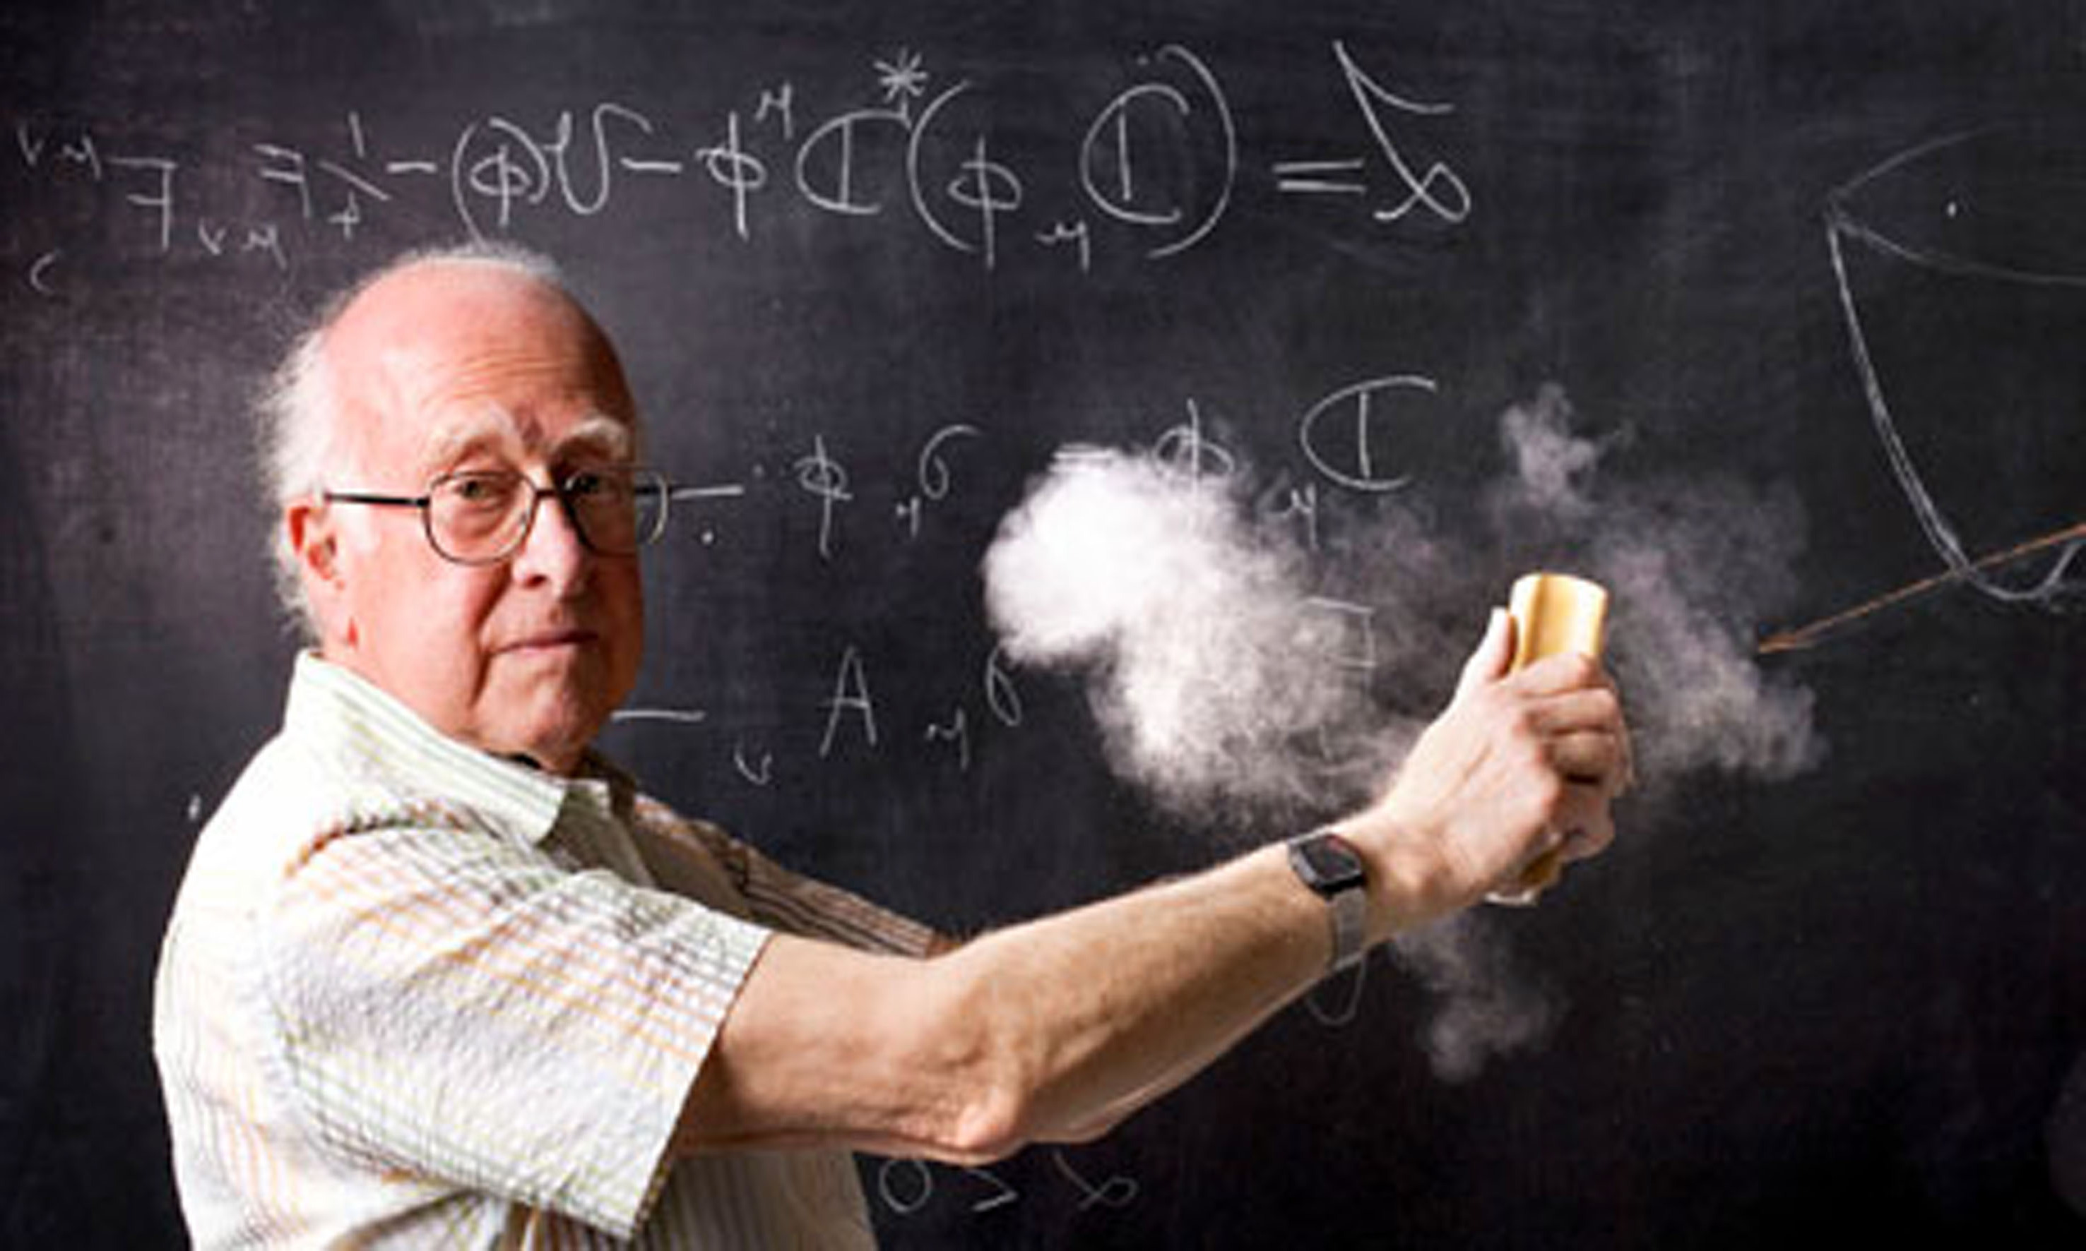
OUTLINE
• Double Higgs Theory
• Motivation for resonant double Higgs
• CMS detector
• Physics object reconstruction in CMS
• Physics data analysis

Slide 3
The story
The problem:
Just a single Higgs is not enough to fully test the Standard Model (SM). Neither is it enough to shed light on which BSM theories are correct.

Slide 4
The story
The problem:
Just a single Higgs is not enough to fully test the Standard Model (SM). Neither is it enough to shed light on which BSM theories are correct.
The hero:
Double Higgs (HH) comes in handy. ☺

Slide 5
The story
The problem:
Just a single Higgs is not enough to fully test the Standard Model (SM). Neither is it enough to shed light on which BSM theories are correct.
The hero:
Double Higgs (HH) comes in handy. ☺
The drama:
HH is not feasible with the current LHC data. ☹

Slide 6
The story
The problem:
Just a single Higgs is not enough to fully test the Standard Model (SM). Neither is it enough to shed light on which BSM theories are correct.
The hero:
Double Higgs (HH) comes in handy. ☺
The drama:
HH is not feasible with the current LHC data. ☹
The solution:
In BSM, the HH cross section is enhanced and we may be able to see it!

Slide 7
The story
The problem:
Just a single Higgs is not enough to fully test the Standard Model (SM). Neither is it enough to shed light on which BSM theories are correct.
The hero:
Double Higgs (HH) comes in handy. ☺
The drama:
HH is not feasible with the current LHC data. ☹
The solution:
In BSM, the HH cross section is enhanced and we may be able to see it!
The action:
Let’s use CMSSW, Crab, GRID, Python, C++, Swan, TMVA, RooStats, Matplotlib etc … to search for the Double Higgs!

Slide 8
Higgs and HH Theory

Slide 9
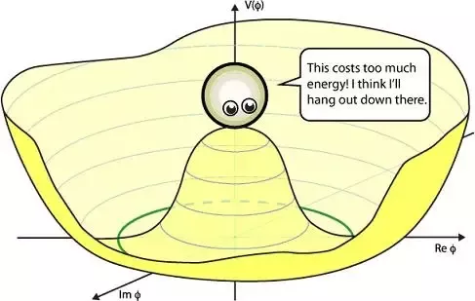
Higgs potential in the SM
Higgs potential is set by μ and λ

Slide 10
Higgs potential in the SM
Higgs potential is set by μ and λ
In 2012 with single Higgs, the mass was measured (μ)

Slide 11
Higgs potential in the SM
Higgs potential is set by μ and λ
In 2012 with single Higgs, the mass was measured (μ)
For λ, we need need higher order interactions

Slide 12
Higgs potential in the SM
Higgs potential is set by μ and λ
In 2012 with single Higgs, the mass was measured (μ)
For λ, we need need higher order interactions
Double Higgs is the way to measure λ

Slide 13
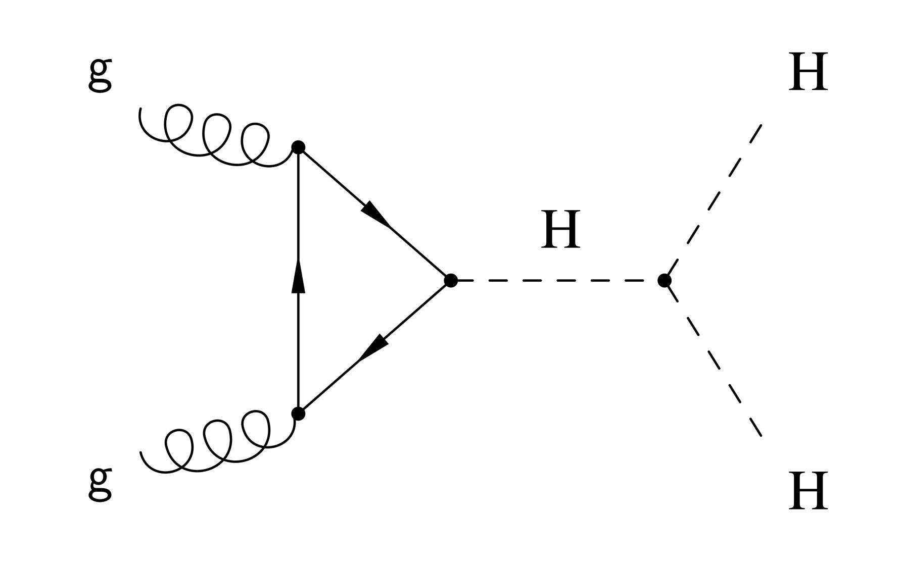
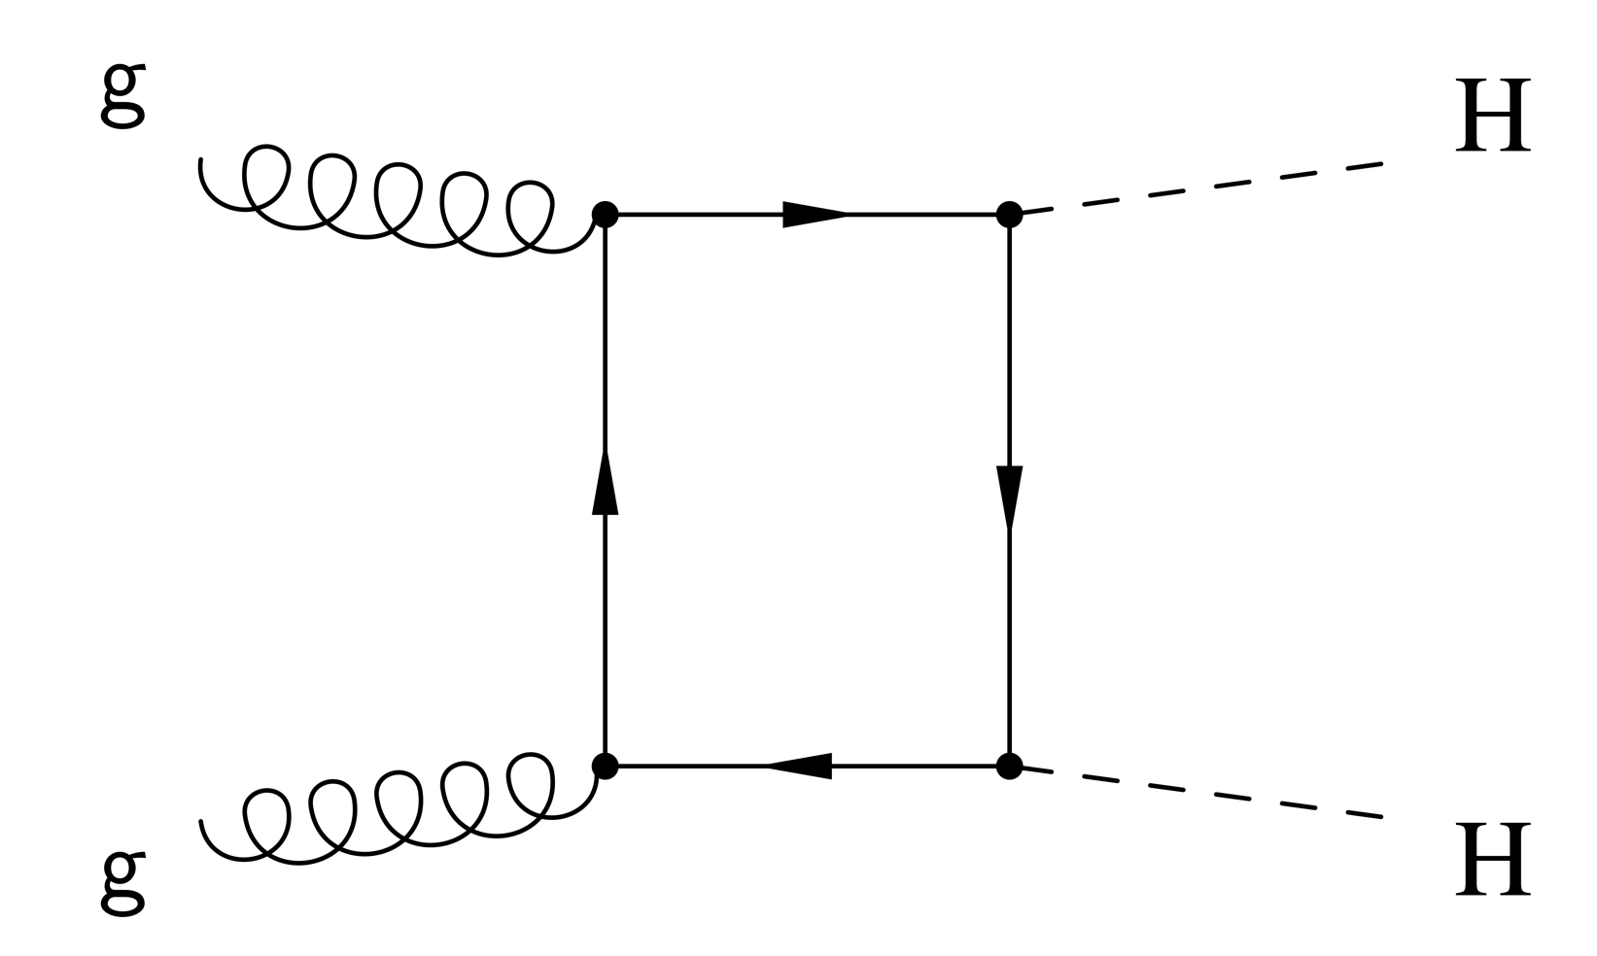
HH Theory in the SM
• In SM, HH production is non-resonant :
- Two diagrams interfering destructively
- Low cross section: σ^{HH}_{SM}≈ 33.45 fb at 13 TeV
• We are not sensitive to the SM HH with the current LHC data ☹

Slide 14
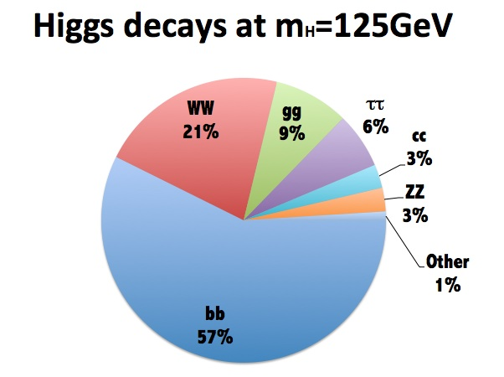
Higgs boson decays
• bb decay for the highest branching fraction
• ZZ* decay with Z to ee/μμ gives handles to improve the sensitivity

Slide 15
Motivation for the resonant double Higgs search

Slide 16
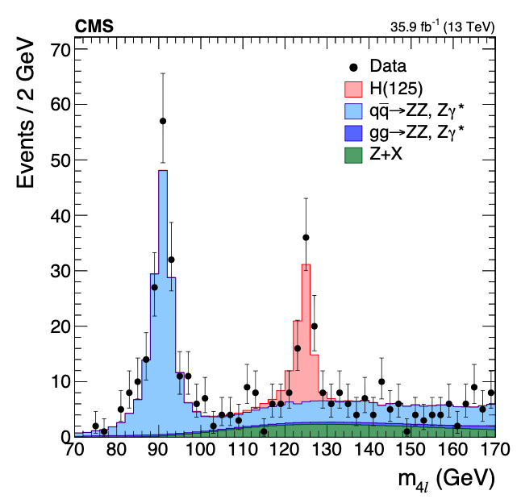
Motivation for the resonant HH
HH production in BSM could be resonant:
- Predicted by many BSM theories
*Just an example of a resonance
(peaky distribution)

Slide 17
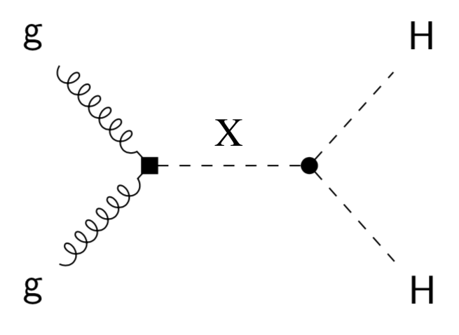
Motivation for the resonant HH
HH production in BSM could be resonant:
- Predicted by many BSM theories
- Modified coupling constants can significantly increase σ^{HH}
- Two types of particles: spin-0 (radion) and spin-2 (graviton)

Slide 18
Motivation for the resonant HH
HH production in BSM could be resonant:
- Predicted by many BSM theories
- Modified coupling constants can significantly increase σ^{HH}
- Two types of particles: spin-0 (radion) and spin-2 (graviton)
- Model-independent strategy for experimentalists: look for ‘model
independent’ narrow width resonances

Slide 19
LHC and CMS detector

Slide 20
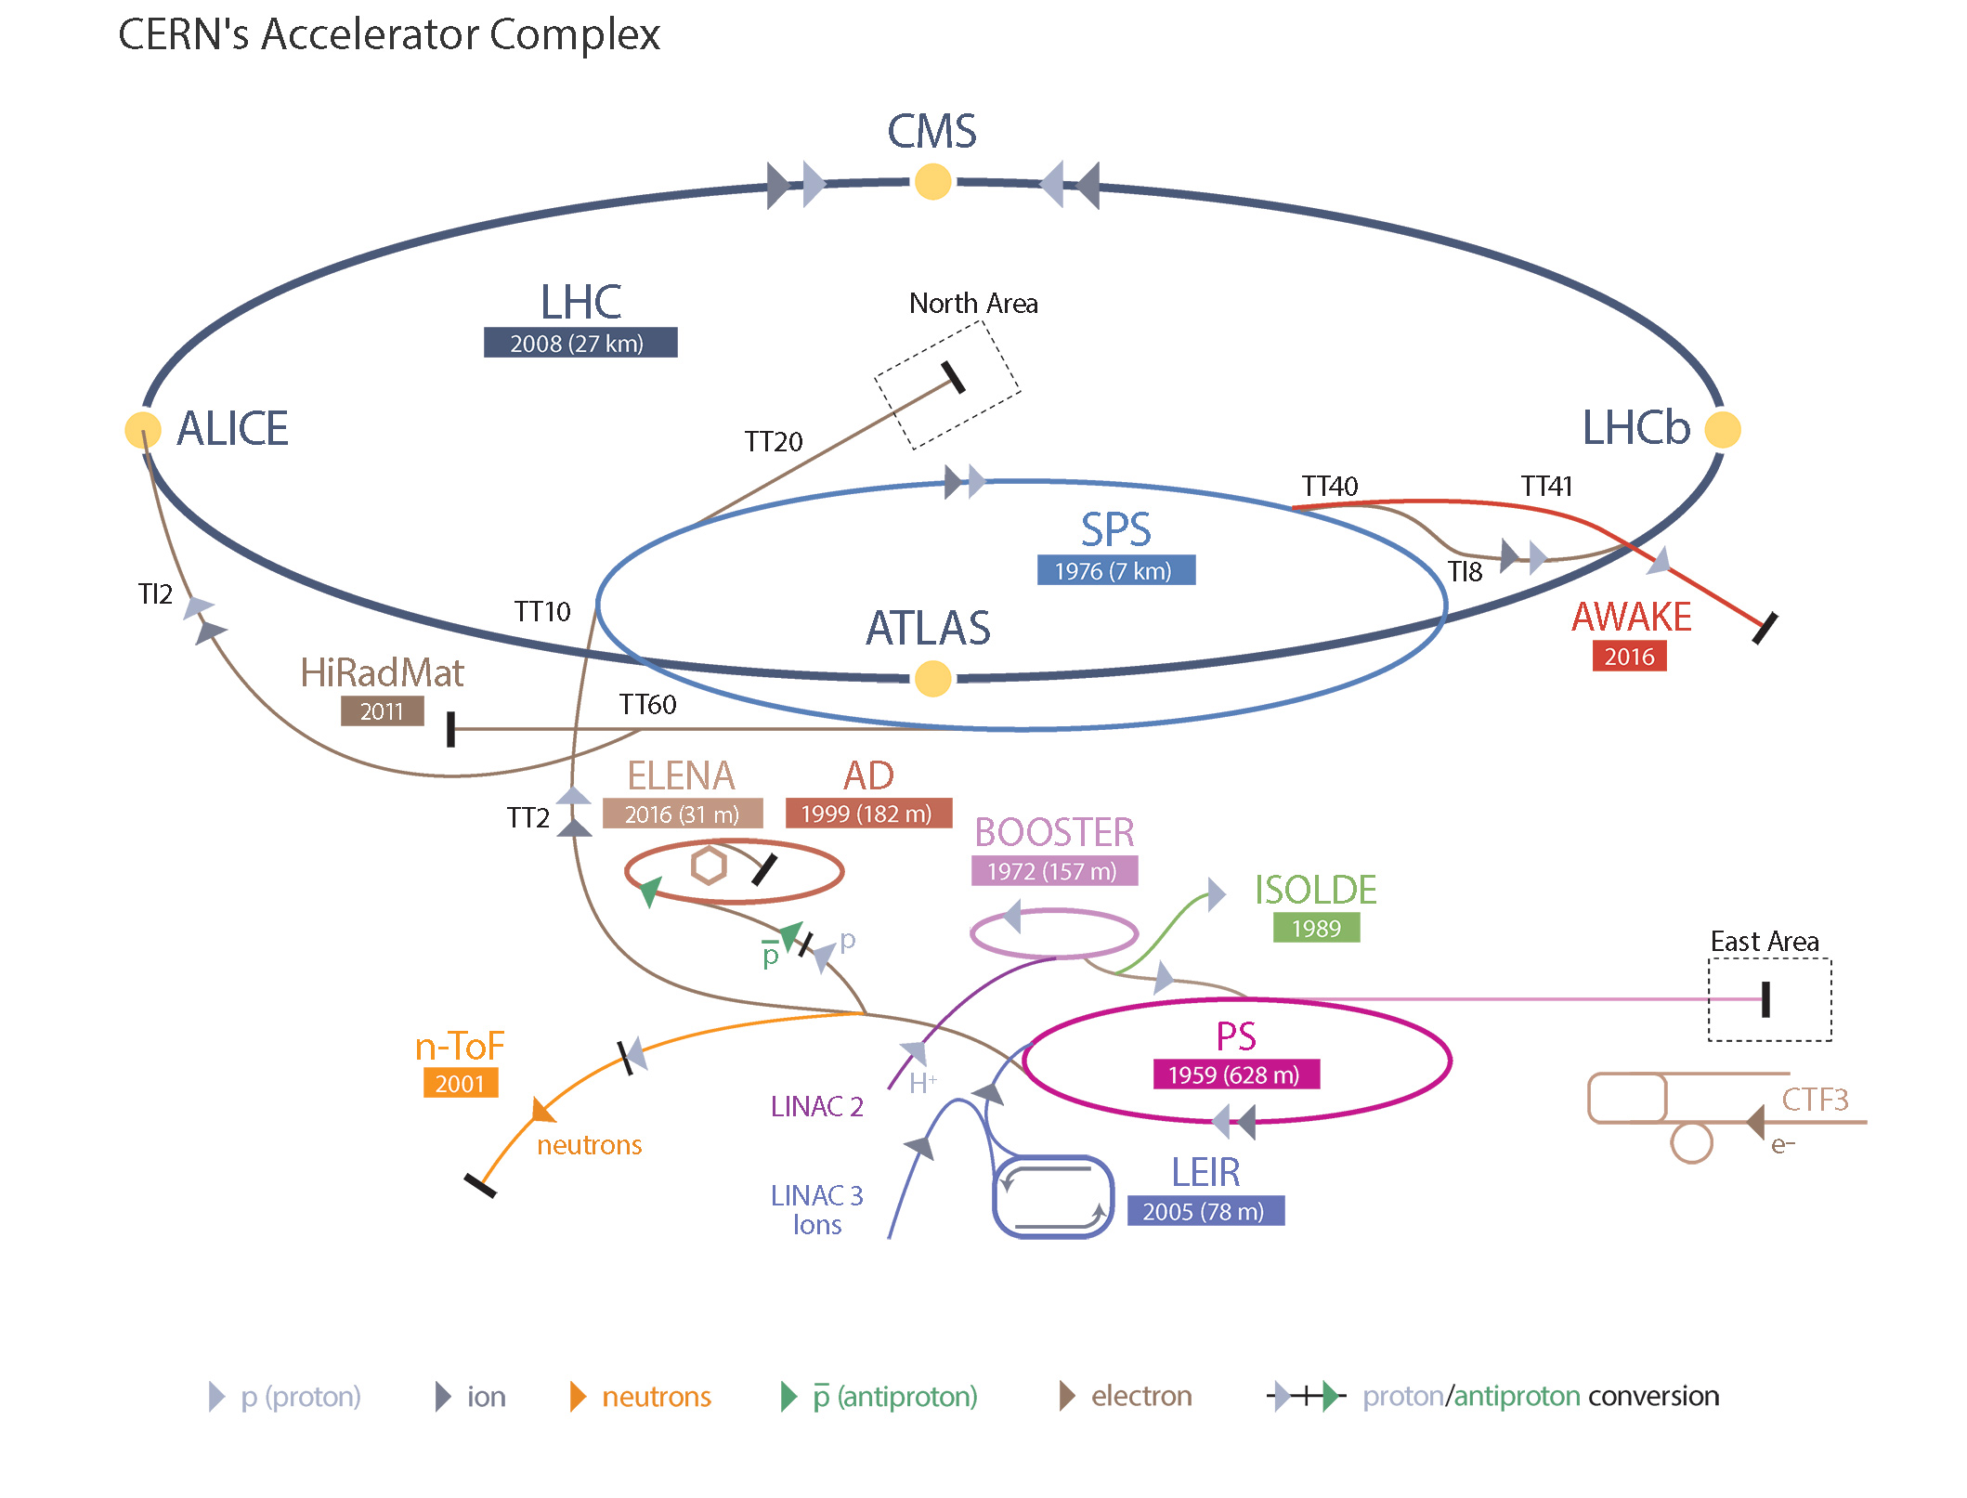
Large Hadron Collider (LHC)
Notes:
Buttons. Click on any particle type to display the relevant slide with animations. Clicking again will return to this slide.
Recommend putting this slide in the middle of your presentation and putting the other 5 slides at the end.
If you have any difficulties, contact David.Barney@cern.ch

Slide 21
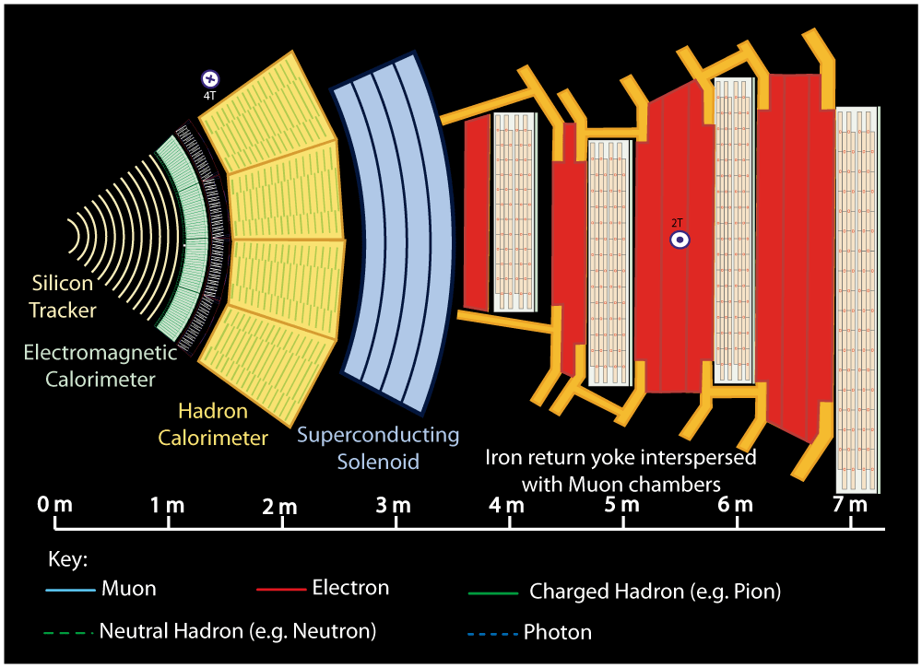
Slice of Compact Muon Solenoid detector (CMS)
Notes:
Buttons. Click on any particle type to display the relevant slide with animations. Clicking again will return to this slide.
Recommend putting this slide in the middle of your presentation and putting the other 5 slides at the end.
If you have any difficulties, contact David.Barney@cern.ch

Slide 22
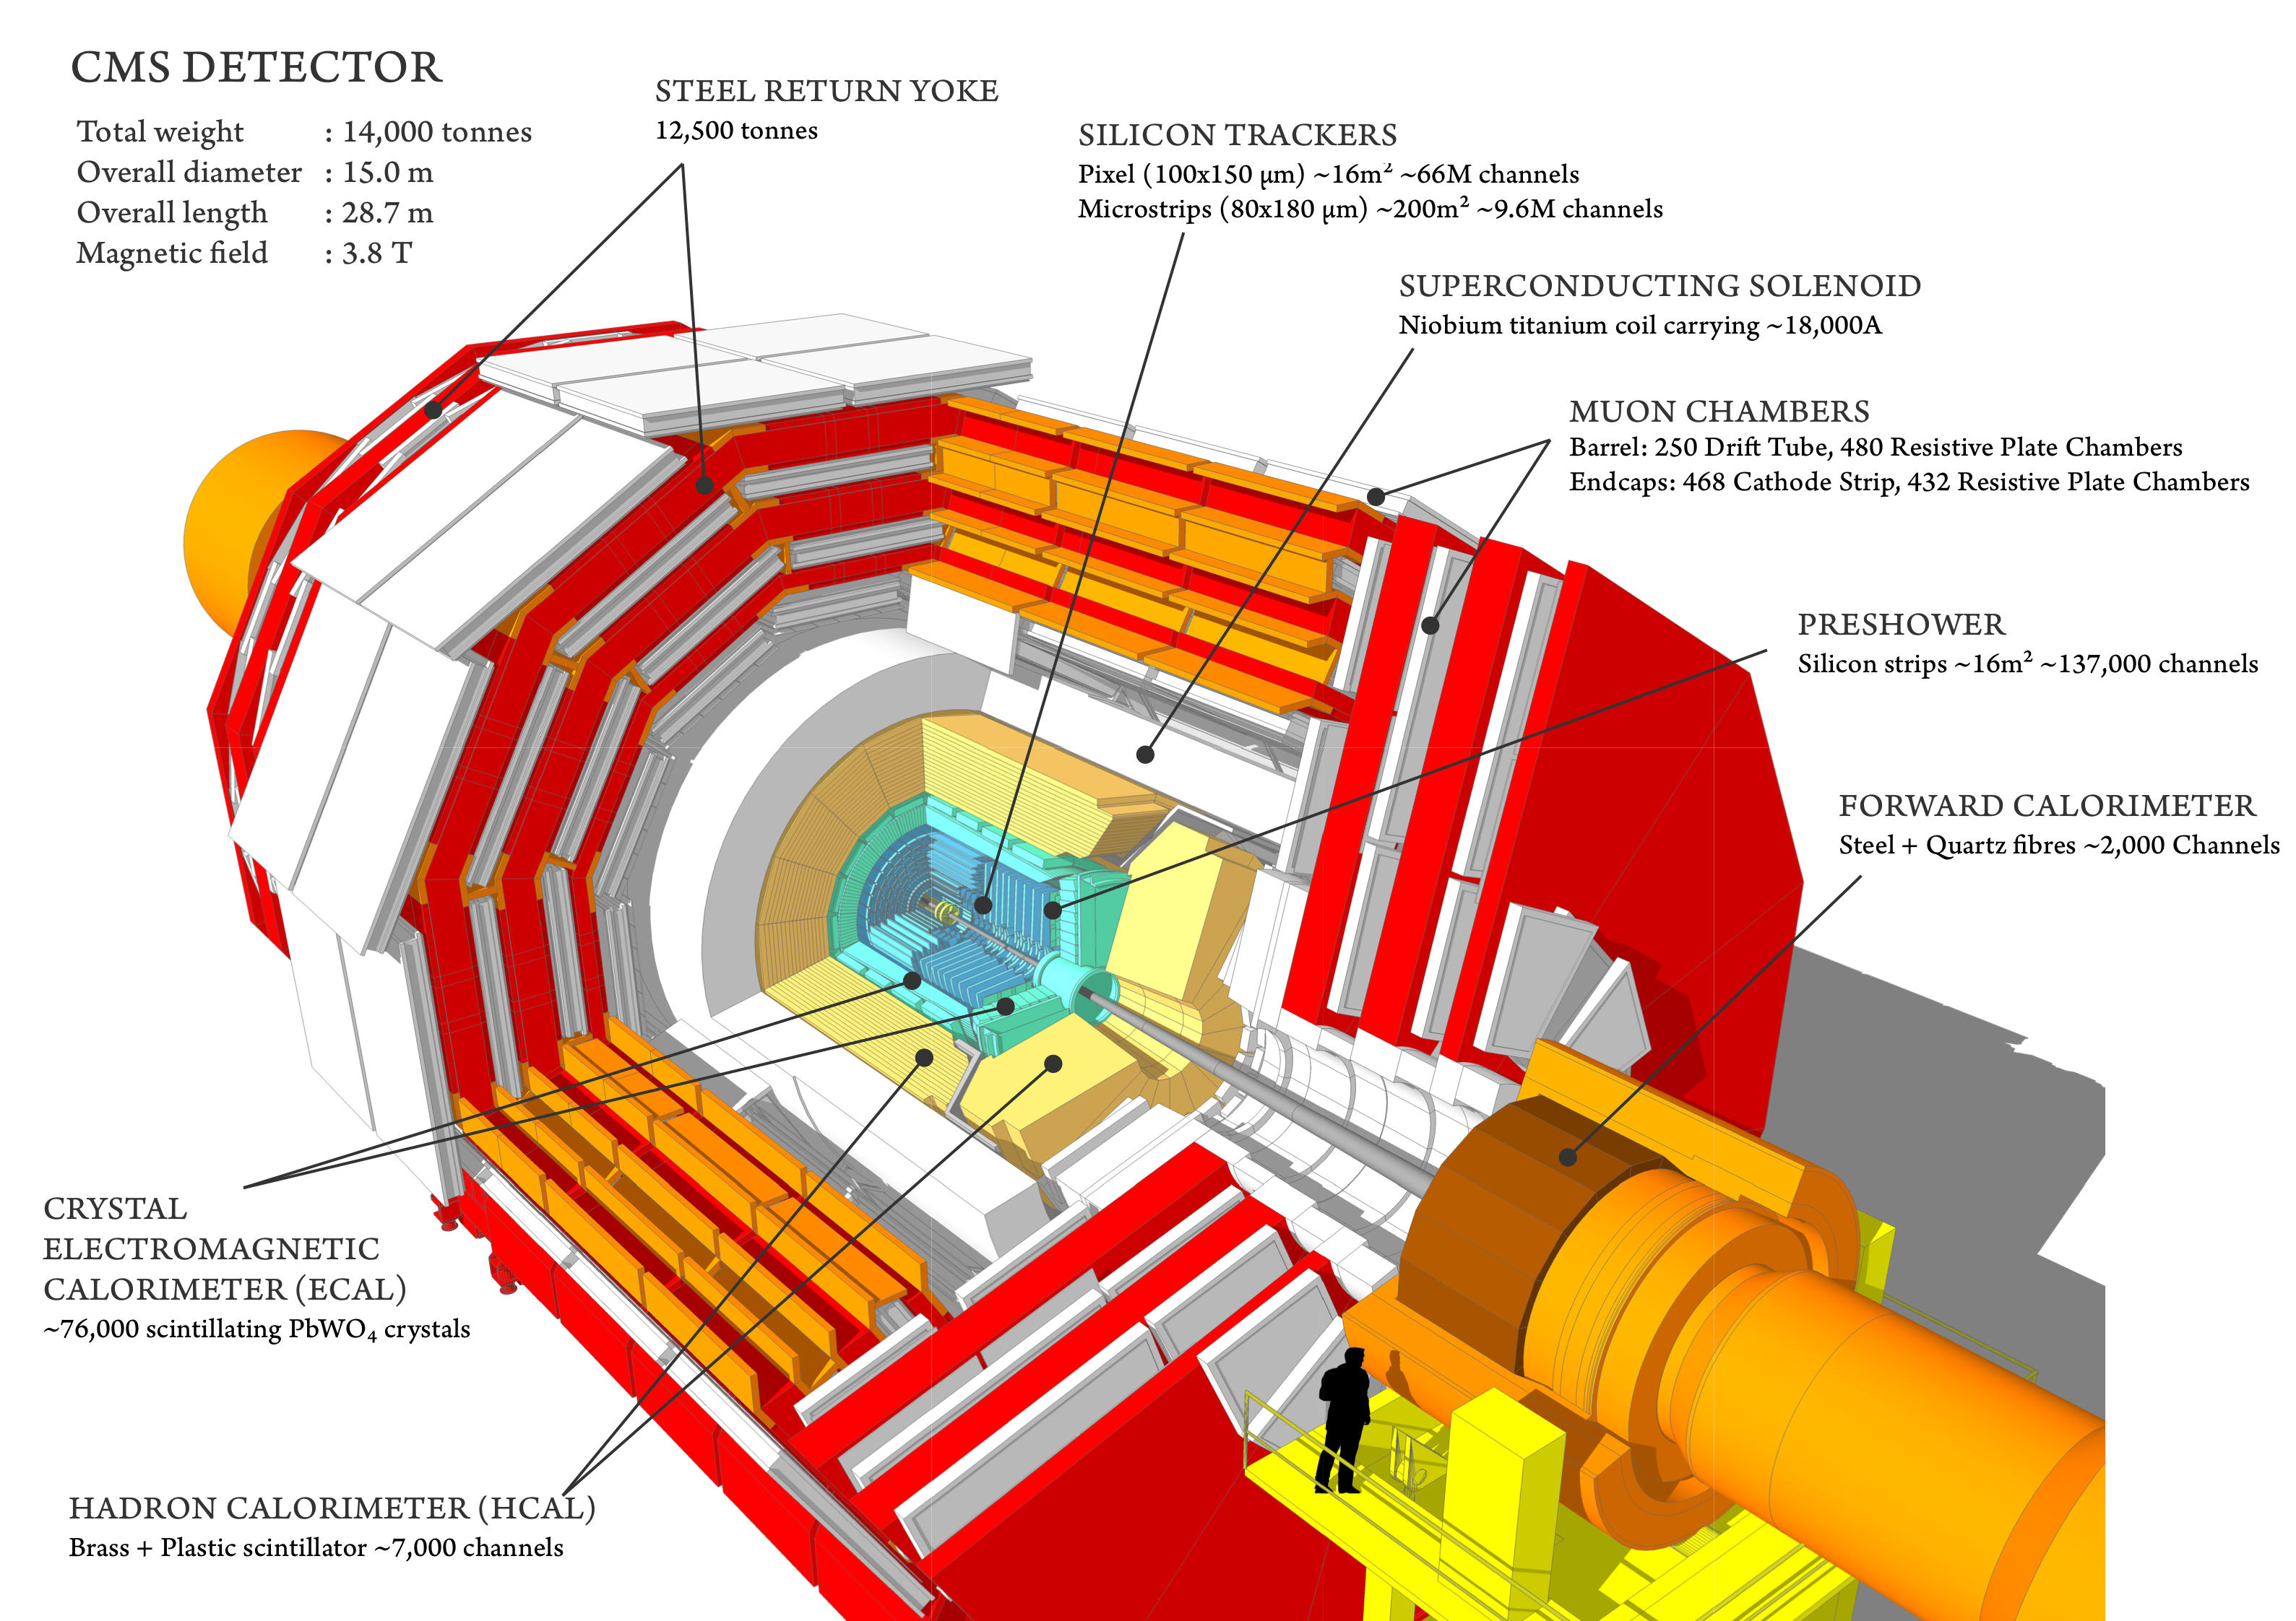
CMS detector

Slide 23
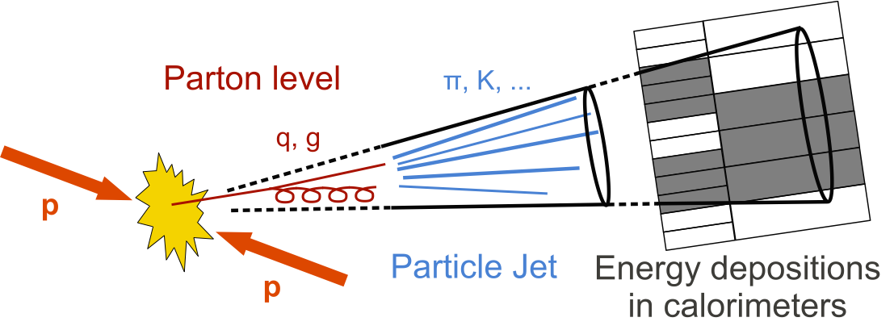
Reconstructed physics objects
Jets:
Jets are collimated streams of particles. As quarks propagate through the CMS detector and hadronize/produce jets, they leave tracks in the tracking system and interaction showers in the calorimeter crystals. We have two jets from Higgs to bb decays.

Slide 24
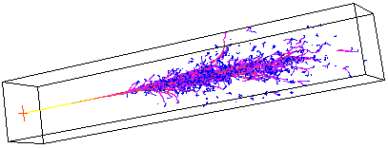
Reconstructed physics objects
Electrons:
Leave tracks in the tracker and create a shower in the ECAL. Are coming from the on-shell Z boson decays.

Slide 25
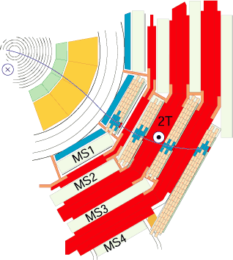
Reconstructed physics objects
Muons:
Leave tracks in the tracker, create a small shower in the ECAL, leave hits in the muon system, and escape the detector. Are coming from the on-shell Z boson decays.

Slide 26
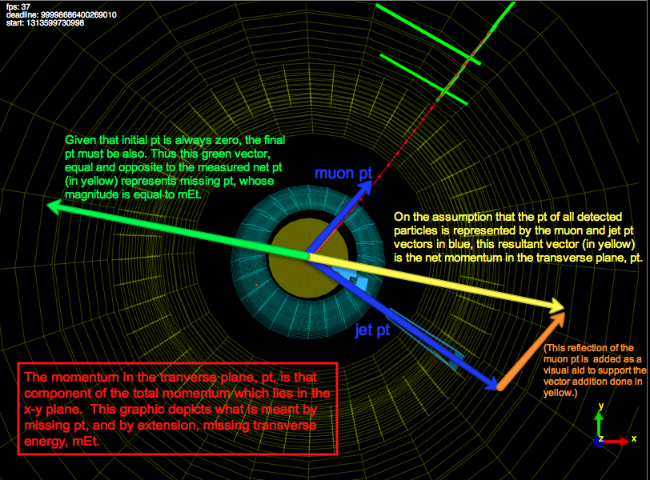
Reconstructed physics objects
Neutrinos or Missing p_{T}:
Neutrinos from off-shell Z bosons are not detected directly, their presence is inferred using the method of the missing transverse momentum.

Slide 27
Physics data analysis

Slide 28
bbZZ: 2b 2l 2ν signature
• MET from the off-shell Z* boson
• 2 leptons (ee, μμ) from on-shell Z
• 2 b jets from the Higgs ➔ bb
H ➔ ZZ*
H ➔ bb
Selected HH system decays maximize sensitivity:
• H to bb has the highest BF, thus increases number of candidates
• H to ZZ*, with on-shell Z to ll because resonant Z selection reduces backgrounds

Slide 29
Analysis setup

Slide 30
Analysis strategy
Object selection
Select
Candidate
Prepare input to Fit
Limits
Requirements on leptons, jets, and met
BDT with nine variables
HH_m_{T} shape
Derive the best limits we can
Our objective is:
• Set 95% CL upper limit on σ(pp X HH) vs mass of X (where X is the spin 0/2 narrow width resonance)
The method we will use to achieve it:
• Binned shape analysis using Maximum Likelihood Fit

Slide 31
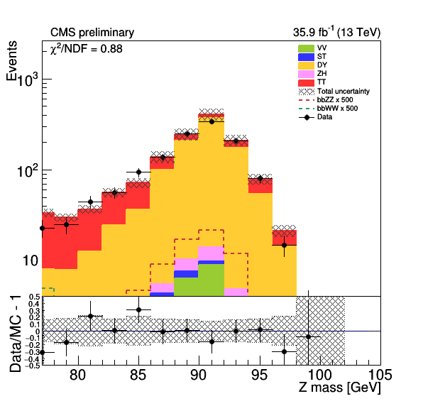
Data and MC samples
DATA
Data collected during 2016:
- DoubleMuon and DoubleEG data sets
SIGNAL: 250 GeV → 1000 GeV
Gluon Fusion → X→ HH → bbZZ → 2b2l2ν for ‘ZZ part’ of signal, the main component
Gluon Fusion → X→ HH → bbWW → 2blνlν for the minor ‘WW part’ of signal
BACKGROUND
Drell-Yan (DY) in association with 1→4 jets
top anti-top (tt)
Single top (ST), Dibosons, and ZH are minor background processes but also pass our selection
*Z to e⁻e⁺

Slide 32
Event selection

Slide 33
Event selection
• Z boson and Higgs boson candidates are defined as:
- Z(μμ): two opposite-sign muons with p_{T} > 20/15 GeV
- Z(ee): two opposite-sign electrons with p_{T} > 25/15 GeV
- H(bb): a pair of b-jets with the highest CMVAv2 discriminant value
H ➔ ZZ*
H ➔ bb

Slide 34
Event selection
• Z boson and Higgs boson candidates are defined as:
- Z(μμ): two opposite-sign muons with p_{T} > 20/15 GeV
- Z(ee): two opposite-sign electrons with p_{T} > 25/15 GeV
- H(bb): a pair of b-jets with the highest CMVAv2 discriminant value
• On the way to HH system select:
- ≧ 2 b-jets
- H_{bb} mass > 20 GeV
- 2 leptons
- 76 GeV < Z_{ll} mass to be orthogonal to bbWW measurement
- Missing p_{T} selection to be orthogonal to bbZZ in 2b2l2q state
- Z_{ll} + H_{bb} + missing p_{T} ≈ HH candidate
- Requirement on the pseudo-transverse
mass of HH ≧ 100 GeV
H ➔ ZZ*
H ➔ bb

Slide 35
Signal and control regions
Signal region is a signal-enriched region
Control regions are defined for each of the main backgrounds to
determine (“control”) their normalizations
Signal Region (SR): Z_{ll} mass = [76, 106], H_{bb} mass = [90, 150]
Control region DY (CRDY): Z_{ll} mass = [76, 106], H_{bb} mass = ]90-150[
Control region TT (CRTT): Z_{ll} mass > 106, H_{bb} mass = [90, 150]
CRDY
20 90 150 Hbb mass
SR
CRTT
CRDY
76 106 Zll mass

Slide 36
Background reduction

Slide 37
BDT discriminant
To reduce background contamination in the SR: require a BDT selection
*High mass region

Slide 38
BDT discriminant
To reduce background contamination in the SR: require a BDT selection
BDTs are trained on bbZZ signal vs DY&tt events
*High mass region

Slide 39
BDT discriminant
To reduce background contamination in the SR: require a BDT selection
BDTs are trained on bbZZ signal vs DY&tt events
BDT selections are optimized for each mass hypothesis in 250 → 1000 GeV and each channel (ee/μμ) separately to yield the lowest limit
*High mass region

Slide 40
BDT discriminant
To reduce background contamination in the SR: require a BDT selection
BDTs are trained on bbZZ signal vs DY&tt events
BDT selections are optimized for each mass hypothesis in 250 → 1000 GeV and each channel (ee/μμ) separately to yield the lowest limit
The mass range is split into two:
- Low mass (250 → 450 GeV)
- High mass (450 → 1000 GeV)
*High mass region

Slide 41
BDT discriminant
To reduce background contamination in the SR: require a BDT selection
BDTs are trained on bbZZ signal vs DY&tt events
BDT selections are optimized for each mass hypothesis in 250 → 1000 GeV and each channel (ee/μμ) separately to yield the lowest limit
The mass range is split into two:
- Low mass (250 → 450 GeV)
- High mass (450 → 1000 GeV)
The input to BDT is a set of nine variables:
- M_{T} and p_{T} of Z boson and Higgs boson candidates
- ΔR between leptons and ΔR between b jets
- Missing p_{T} (MET)
*High mass region

Slide 42
Data-MC disagreements

Slide 43
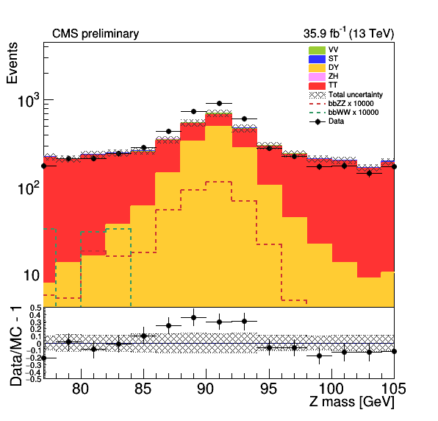
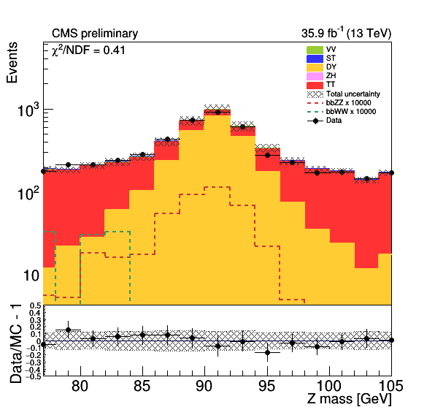
Data-MC discrepancies
No Scale Factors
After Scale Factors are applied
• Lepton efficiencies
• b tagging and light flavor mistagging probability
• Kinematic reweighting of the DY plus jets samples
- Δη_{bb}
- p_{T}(Z)

Slide 44
Maximum likelihood fit

Slide 45
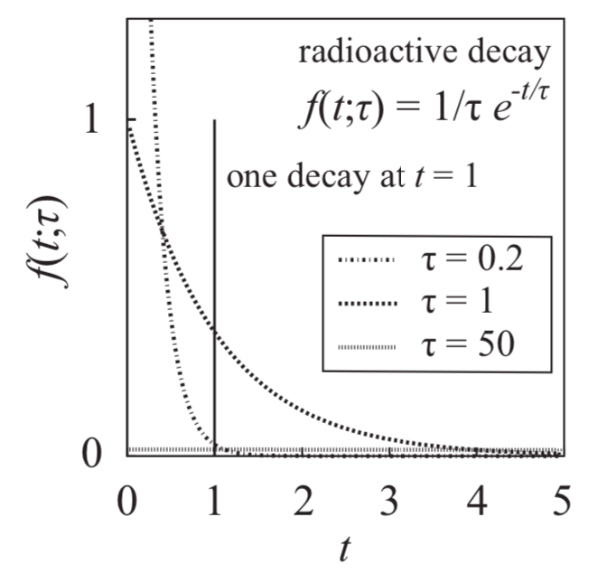
Maximum Likelihood Method
If the assumed probability density function and its parameters are correct, we expect higher values of the likelihood function than for wrong parameter values.

Slide 46
Maximum Likelihood Method
If the assumed probability density function and its parameters are correct, we expect higher values of the likelihood function than for wrong parameter values.
Example: Radioactive decay following the exponential decay law f(t; τ) = exp(-t/τ)/τ.

Slide 47
Maximum Likelihood Method
If the assumed probability density function and its parameters are correct, we expect higher values of the likelihood function than for wrong parameter values.
Example: Radioactive decay following the exponential decay law f(t; τ) = exp(-t/τ)/τ.
The likelihood function L(t; τ) = f (t; τ) is shown for three different hypothetical lifetime parameter values τ as a function of the observed time t.

Slide 48
Maximum Likelihood Method
If the assumed probability density function and its parameters are correct, we expect higher values of the likelihood function than for wrong parameter values.
Example: Radioactive decay following the exponential decay law f(t; τ) = exp(-t/τ)/τ.
The likelihood function L(t; τ) = f (t; τ) is shown for three different hypothetical lifetime parameter values τ as a function of the observed time t.
One decay is observed at the time t.

Slide 49
Maximum Likelihood Method
If the assumed probability density function and its parameters are correct, we expect higher values of the likelihood function than for wrong parameter values.
Example: Radioactive decay following the exponential decay law f(t; τ) = exp(-t/τ)/τ.
The likelihood function L(t; τ) = f (t; τ) is shown for three different hypothetical lifetime parameter values τ as a function of the observed time t.
One decay is observed at the time t.
At the observed time t=1, the curve with τ=1 has a much larger value than others.

Slide 50
Maximum Likelihood Method
If the assumed probability density function and its parameters are correct, we expect higher values of the likelihood function than for wrong parameter values.
Example: Radioactive decay following the exponential decay law f(t; τ) = exp(-t/τ)/τ.
The likelihood function L(t; τ) = f (t; τ) is shown for three different hypothetical lifetime parameter values τ as a function of the observed time t.
One decay is observed at the time t.
At the observed time t=1, the curve with τ=1 has a much larger value than others.
Indeed τ=1 is the maximum-likelihood solution.

Slide 51
Maximum likelihood fit
Index i is reserved for bins of the input distributions
Index j is reserved for uncertainties
n_{i} is the number of observed data events in the bin i
Index k refers to the background process k, and B_{k,i} is the content of the bin i of the background shape for a process k, and S_{i} is the content of the bin i of the signal shape
The parameter r_{k} sets the normalization of the background process k, while r_{signal} is the signal strength parameter
All r parameters float freely in the fit

Slide 52
Systematics

Slide 53
Uncertainties
Normalization:
• Luminosity
• PDF uncertainties
• QCD scale variations
• Cross section normalization
• Pile up
• MET
• Drell-Yan and tt
normalizations
Shape:
• Lepton Scale factors: split into all components
• Jet Energy Scale
• Jet Energy Resolution
• Tagging of a b jet
• Mistagging of a b jet
• Bin-by-Bin MC uncs

Slide 54
Results

Slide 55
Post-fit HH_Mt in SR and CRs
m+m- e+e-
radion (spin 0)
CRDY CRTT SR

Slide 56
Post-fit HH_Mt in SR and CRs
m+m- e+e-
graviton (spin 2)
CRDY CRTT SR

Slide 57
95 % CL upper limits
radion(spin 0) graviton(spin 2)
http://cds.cern.ch/record/2648796?ln=en

Slide 58
Summary
• We have presented the search for resonant HH production with bbZZ decays in 2b2l2ν final state using 35.9 fb⁻¹ of data collected in 2016
• Main backgrounds are DY and tt: fit simultaneously (ML fit) signal and control regions to determine their normalizations
• Use BDTs to reduce background contamination in the signal region
• Combination of ee and μμ channels was used to derive limits as a function of mass of a narrow width spin 0/2 resonance decaying to HH
• Though model-independent, interpretation of results is done in WED theory
• This is the world-first search for double Higgs boson production in the bbZZ intermediate channel

Slide 59
59
Thank you!

Slide 60
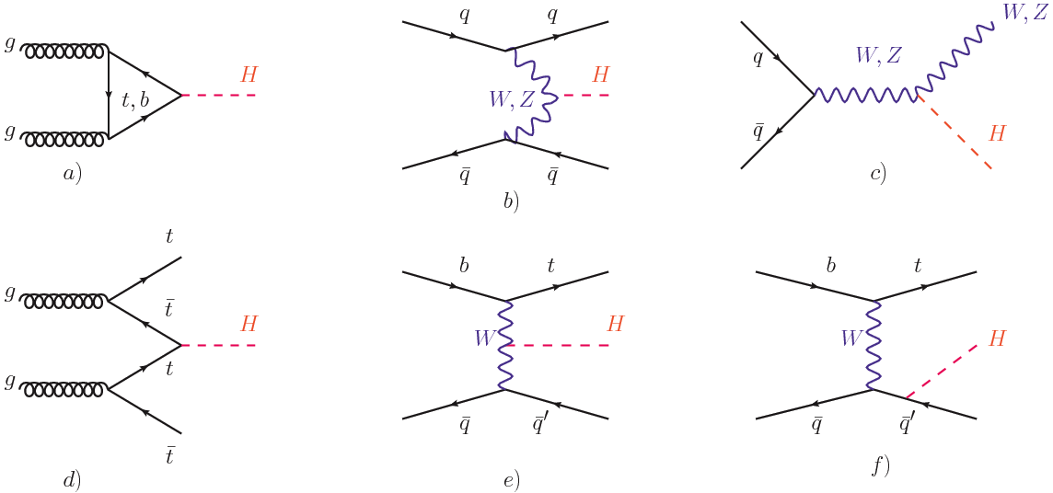
Single Higgs boson production
87% 7% 5%
19.5 pb 1.6 pb 0.7 and 0.39 pb
0.5% <0.5% <0.5%
0.13 pb <0.1 pb <0.1 pb

Slide 61
Higgs potential in the SM
Higgs potential is set by μ and λ
In 2012, with single Higgs measured mass (μ)
For λ need need higher order interactions
Double Higgs is the way to measure λ

Slide 62
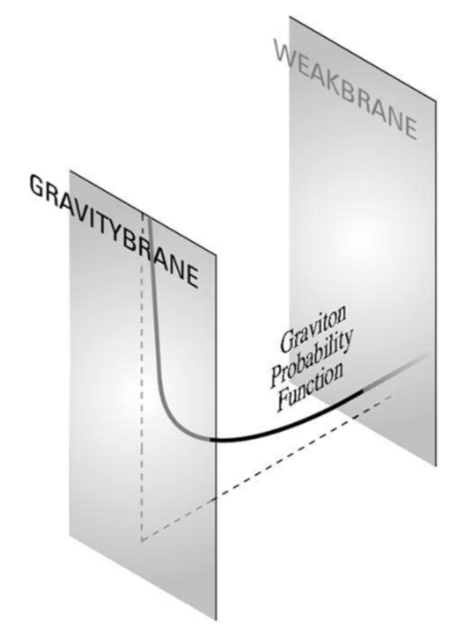
WED space structure

Slide 63
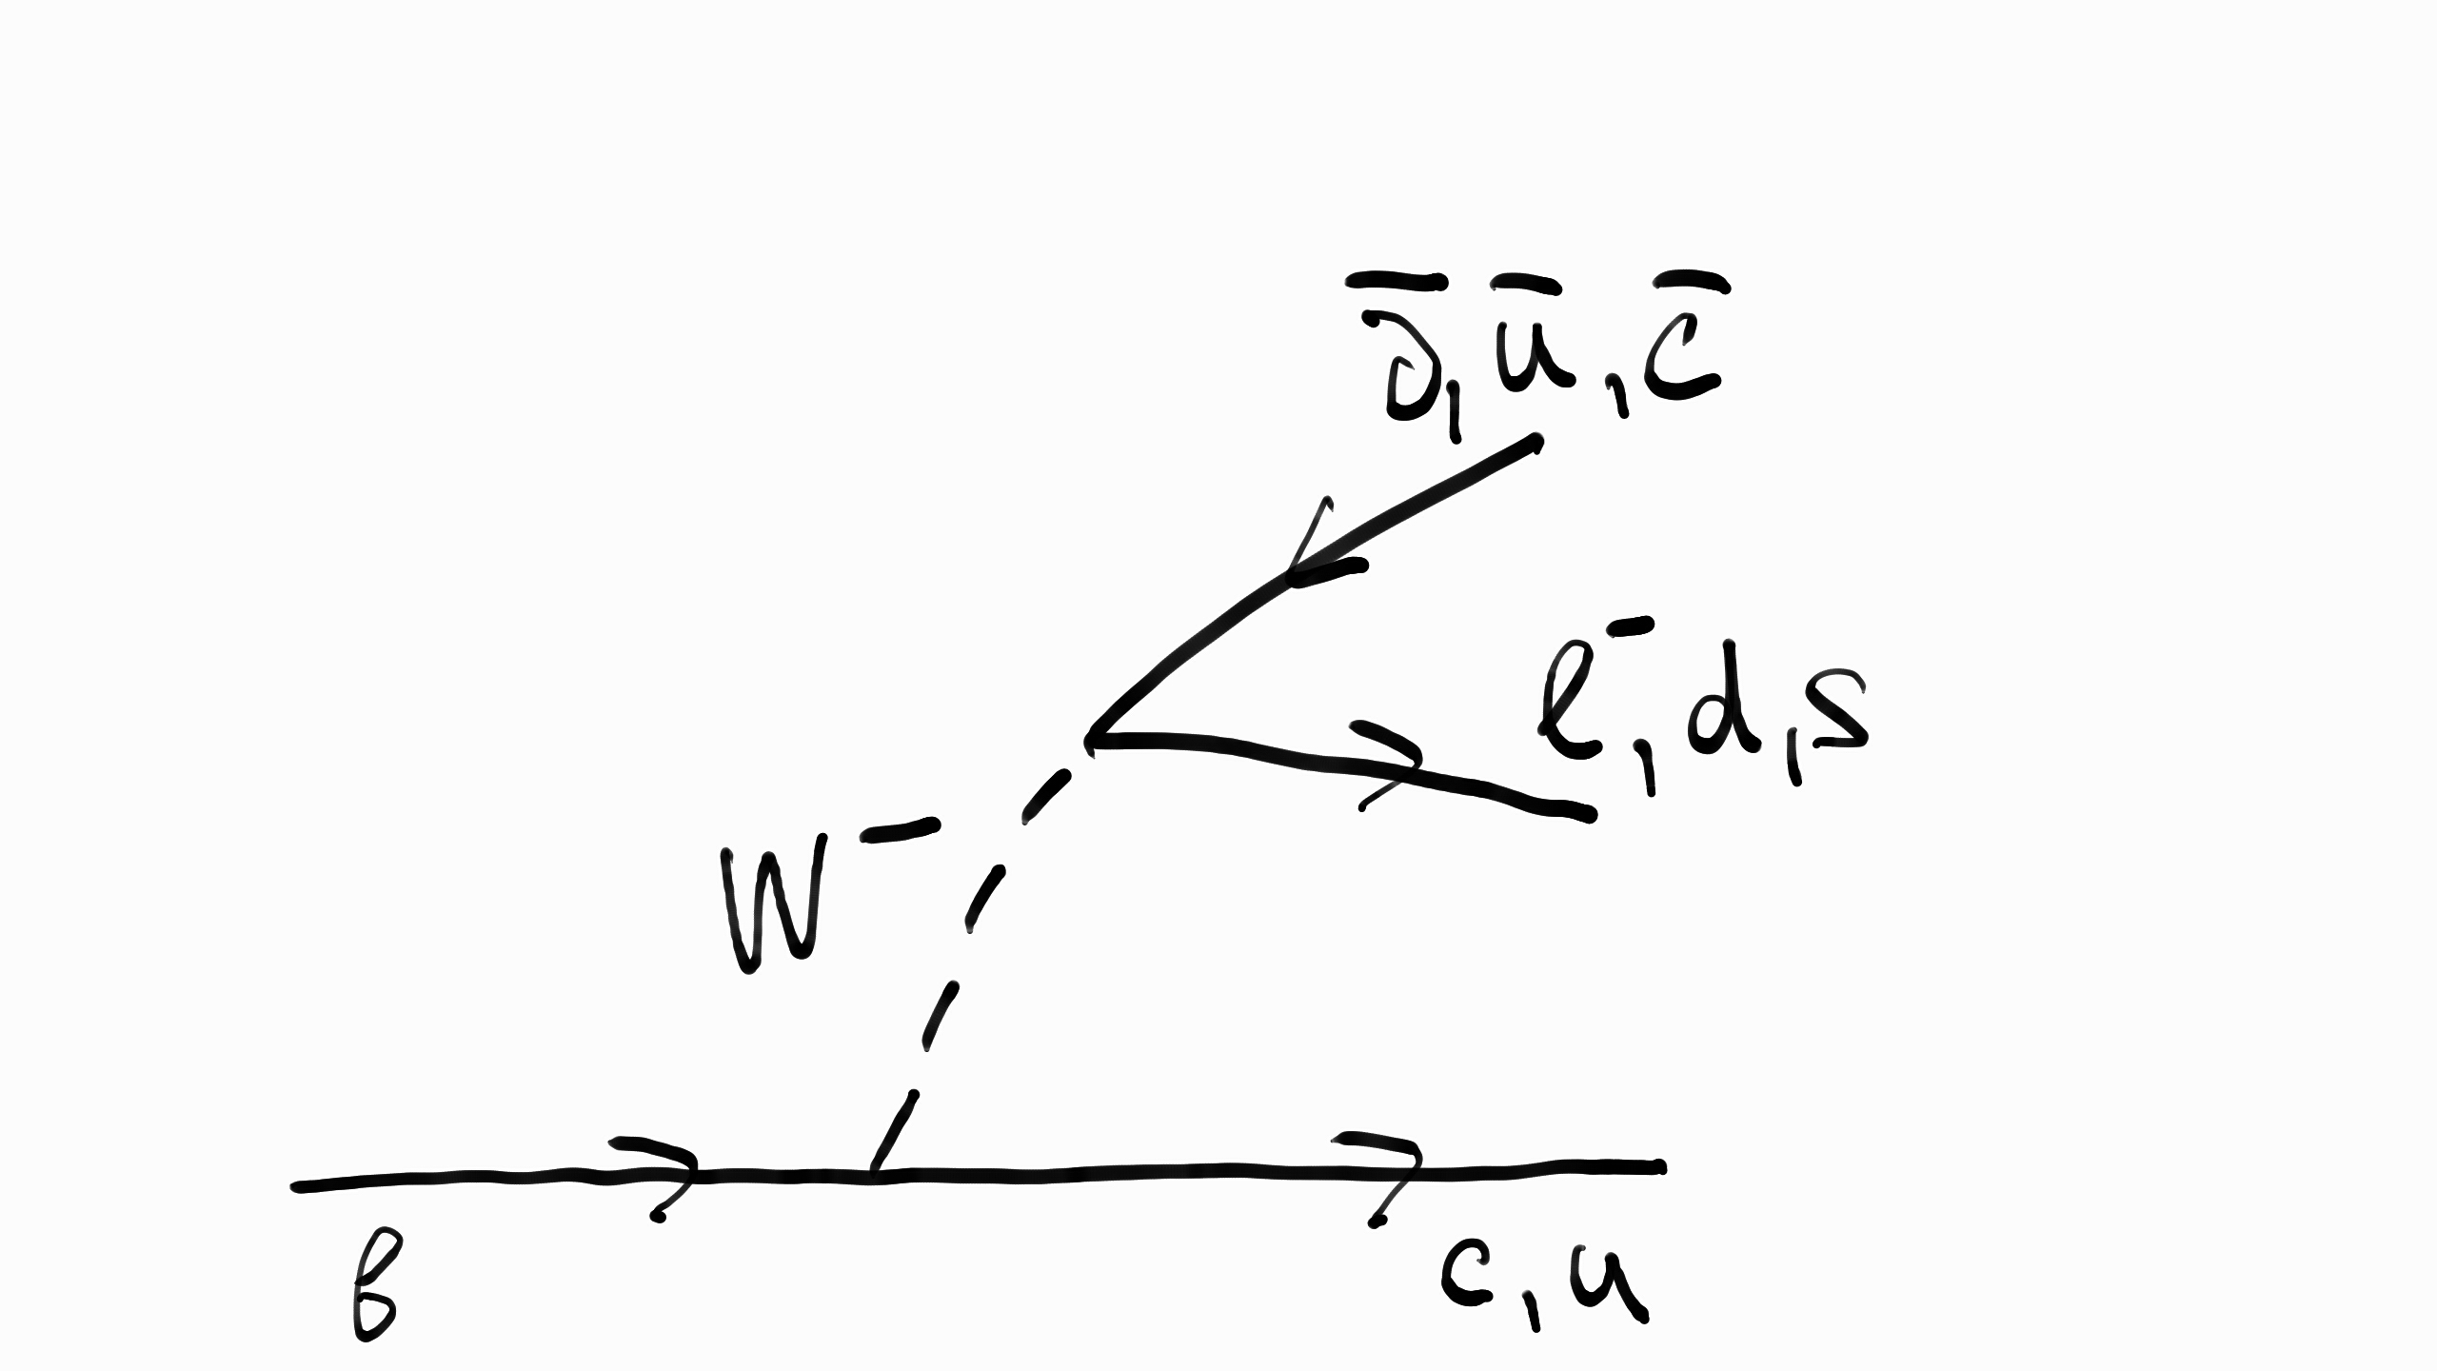
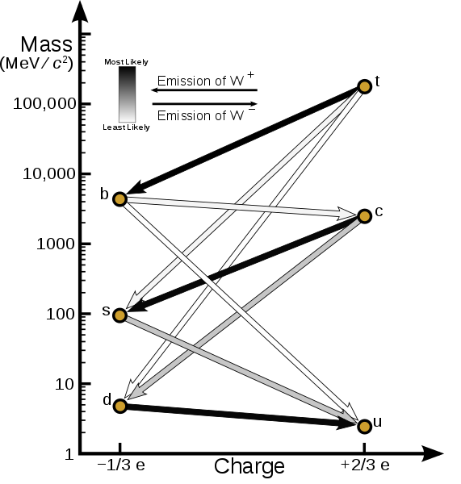
B quark decays

Slide 64
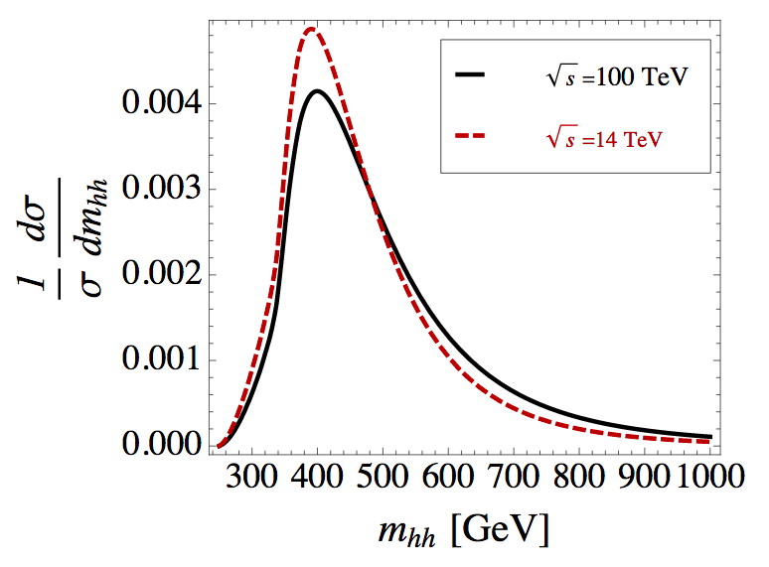
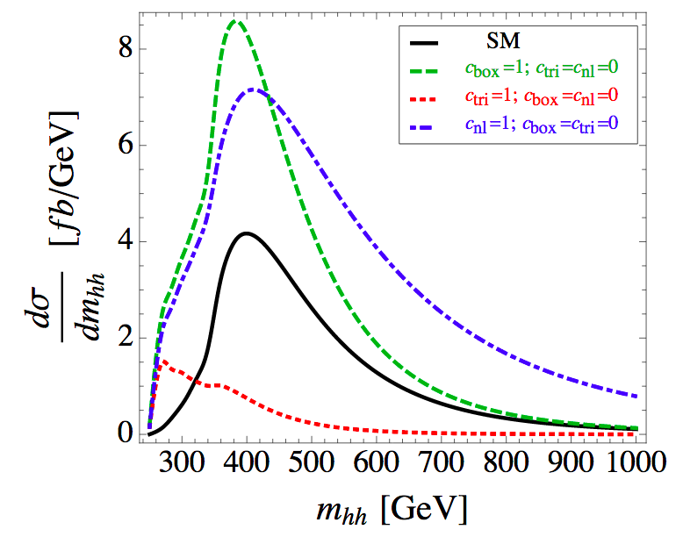
Double Higgs boson mass distribution in the SM at the LO
Left: Comparison of the double Higgs boson mass distribution in the SM at the LO at 14 and 100 TeV center-of-mass energy.
Right: the total SM HH cross section and the individual contributions.
Green refers to the SM box production, red refers to the SM triangle production, and blue refers to BSM non-linear ttHH production, not included in the total SM production (in black)

Slide 65
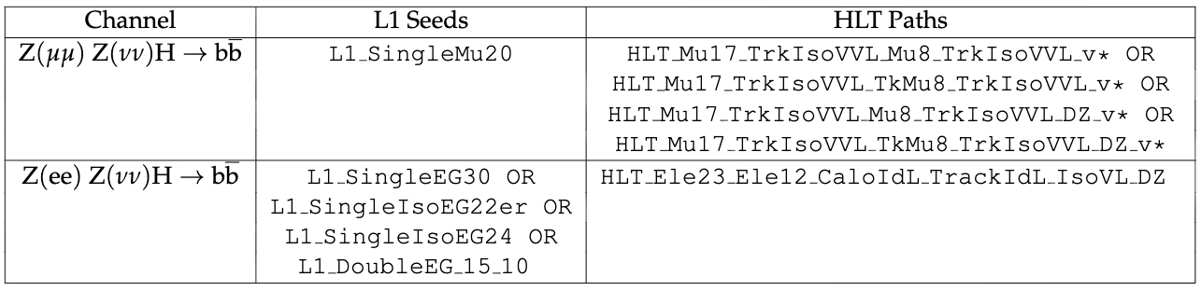
Triggers
Triggers for dimuon and dielectron analysis channels both at L1 and HLT levels.

Slide 66
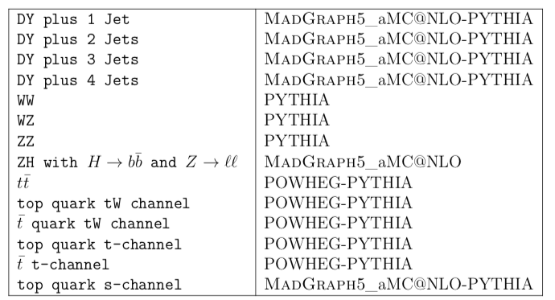
MC samples
Signal samples and DY are at LO using MadGraph5_aMC@NLO, Pythia for parton showering and hadronization
DY is reweighted to NLO using Δη_{bb} and p_{T}(Z)
Top quark at NLO:
1) t-channel, tW, tt using POWHEG
2) s-channel using MadGraph5_aMC@NLO
Single top is rescaled to NNLO
Dibosons at LO using Pythia and rescaled to NLO
ZH at NLO using MadGraph5_aMC@NLO and rescaled to NNLO

Slide 67
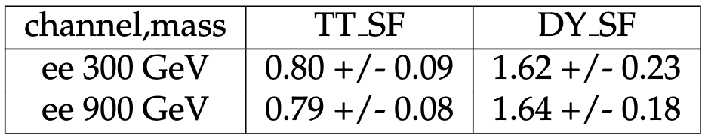
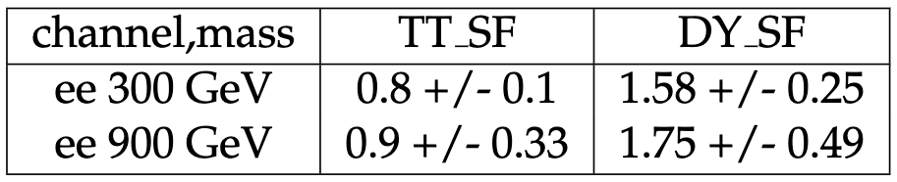
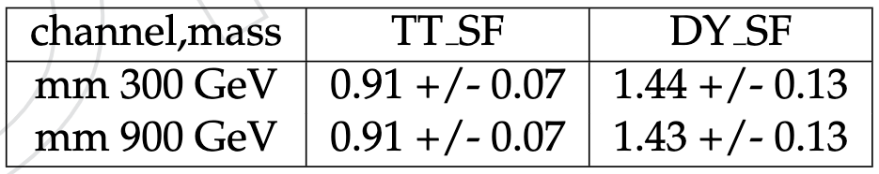
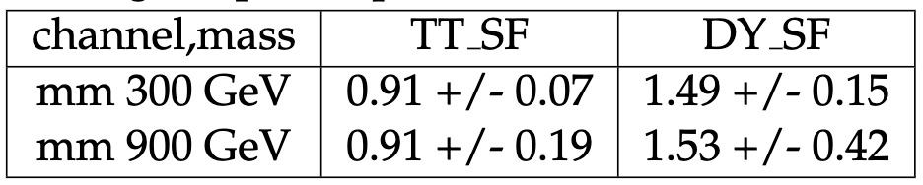
DY and TT SFs from the fit
Normalization for backgrounds, final numbers after the application of all the nui-sances during the postfit procedure. Electron channel. All regions are used.
Normalisation for backgrounds in the unblinded SR only, final numbers after the applica-tion of all the nuisances during the postfit procedure. Electron channel.
Normalization for backgrounds, final numbers after the application of all the nui-sances during the postfit procedure. Muon channel. All regions are used.
Normalisation for backgrounds in the unblinded SR only, final numbers after the applica-tion of all the nuisances during the postfit procedure. Muon channel.

Slide 68
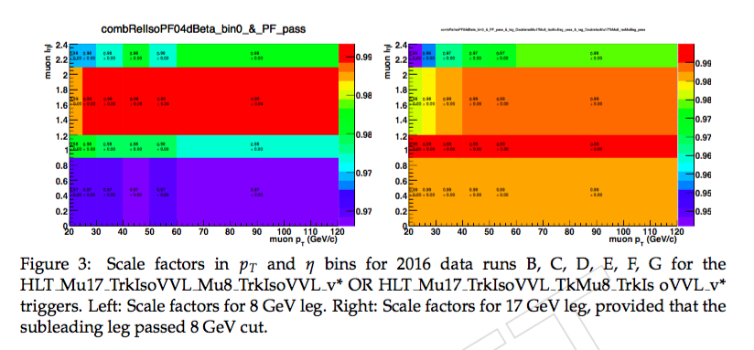
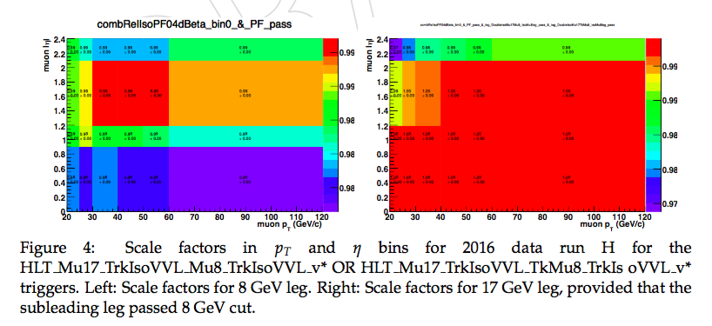
HLT SFs for dimuon triggers
HLT_BIT_HLT_Mu17_TrkIsoVVL_Mu8_TrkIsoVVL_v or HLT_BIT_HLT_Mu17_TrkIsoVVL_Mu8_TrkIsoVVL_DZ_v or HLT_BIT_HLT_Mu17_TrkIsoVVL_TkMu8_TrkIsoVVL_v or HLT_BIT_HLT_Mu17_TrkIsoVVL_TkMu8_TrkIsoVVL_DZ_v

Slide 69
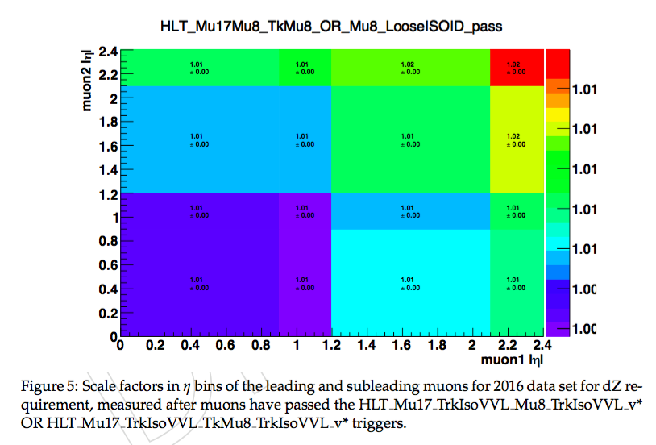
HLT SFs for dimuon triggers, dZ requirement
HLT_BIT_HLT_Mu17_TrkIsoVVL_Mu8_TrkIsoVVL_v or HLT_BIT_HLT_Mu17_TrkIsoVVL_Mu8_TrkIsoVVL_DZ_v or HLT_BIT_HLT_Mu17_TrkIsoVVL_TkMu8_TrkIsoVVL_v or HLT_BIT_HLT_Mu17_TrkIsoVVL_TkMu8_TrkIsoVVL_DZ_v
https://indico.cern.ch/event/636555/contributions/2577291/attachments/1453162/2241537/TnP_DoubleMuSF_03_05_17.pdf

Slide 70
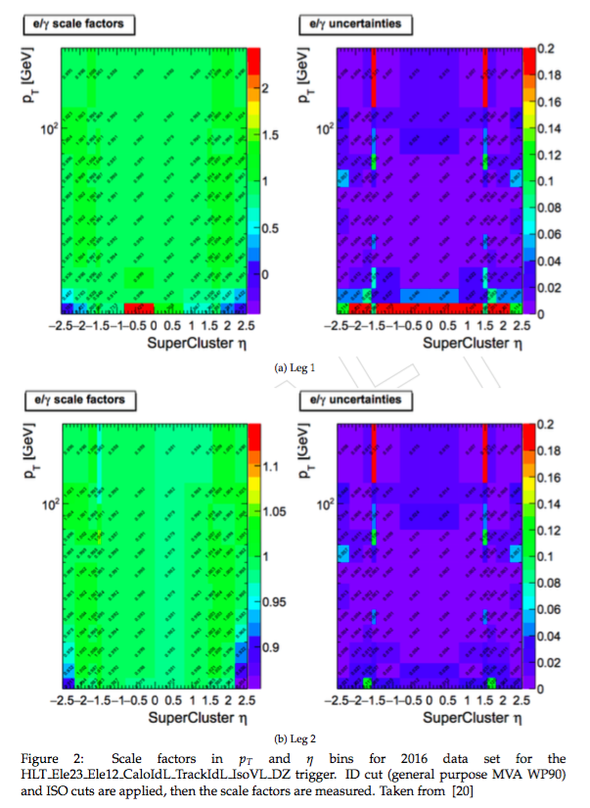
HLT SFs for dielectron trigger
HLT_BIT_HLT_Ele23_Ele12_ CaloIdL_TrackIdL_IsoVL_DZ_v
https://indico.cern.ch/event/604949/contributions/ 2543520/attachments/1439974/2216426/VHbb_TnP _SFs_egamma_april.pdf#search=vhbb%20AND %20cerntaxonomy%3A%22Indico%2FExperiments% 2FCMS%20meetings%2FPH%20%2D%20Physics%2FEgamma%22

Slide 71
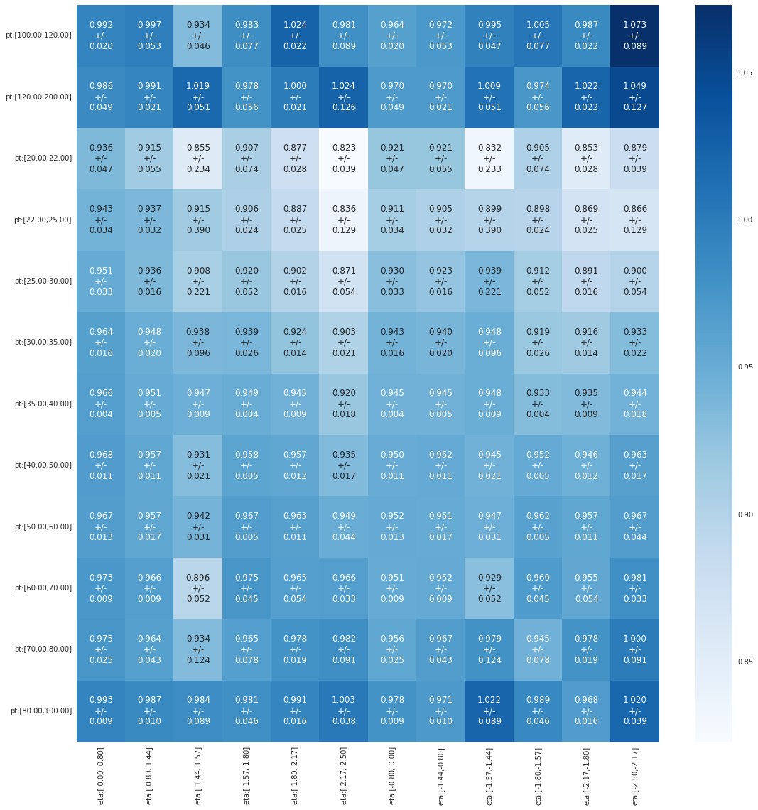
Data-MC discrepancies
• Lepton efficiencies
• b tagging and light flavor mistagging probability
• Kinematic reweighting of the DY plus jets samples
- Δη_{bb}
- p_{T}(Z)
p_{T} slices from 20 to 200 GeV
η slices from -2.5 to 2.5
*Electron ID&ISO scale factors as a function of electron p_{T} and η

Slide 72
Analysis in a nutshell
HH decay in bb ll νν final state
Analysis flow is optimized for a narrow width (O (GeV)) heavy resonance search in the range 250 to 1000 GeV
Boosted Decision Trees classifiers (BDTs) to optimize SR selection:
- 2 BDTs are used: low (≤450 GeV) and high mass regions
Signal extraction:
- Binned shape analysis
- To determine Drell-Yan (DY) and top anti-top (tt) normalizations,
fit simultaneously signal region (SR) and background control regions (CRs)
- HH_Mt shape is used in the fits to extract limits vs mass
- 95% CL upper limits on the production σ of X_{spin 0/2} to HH to 2b2l2ν
We combine di-muon (μμ) and di-electron (ee) channels
Results are compared with the Warped Extra Dimensions (WED) theory

Slide 73
Physics objects and corrections
Jets:
- Particle Flow anti-k_{T} (Charged Hadron Subtracted) jets, JES and JER corrections are applied.
- Loose jet ID and PU-ID applied, also p_{T} > 30 GeV and |η| < 2.4
b tagging
- CMVAv2 algorithm that uses 6 simpler taggers, WP Medium is applied
- b tagging/mistagging scale factors applied as weights
Electrons:
- MVA Identification WP Loose, p_{T} > 25/15 GeV and |η| < 2.5. Identification (ID), Isolation (ISO), High-level Trigger (HLT) scale factors (SFs) are applied
- Particle Flow relative isolation < 0.06 (ρ-subtracted, cone ΔR = 0.3)
Muons:
- Loose global muon, p_{T} > 20/15 GeV and |η| < 2.4, ID, ISO, TRK, HLT SFs
- Particle Flow relative isolation < 0.15 (Δβ-subtracted, cone ΔR = 0.4)
Missing p_{T}:
- Particle Flow missing p_{T} with all needed corrections

Slide 74
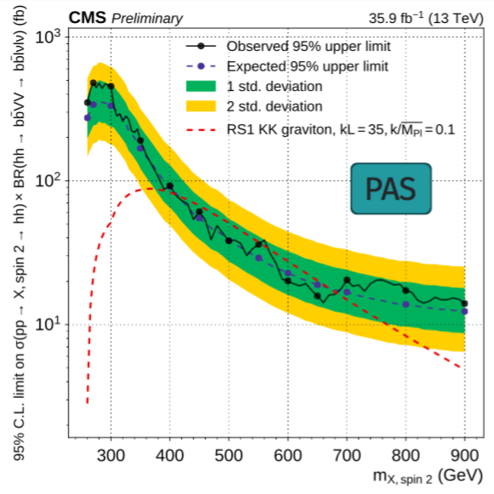
Zll cut to be orthogonal to bbWW
Shown just to make the orthogonality point
bbZZ bbWW is O(20) more sensitive
Known approved bbVV (bbWW) analysis operates strictly in the range Z_{ll} mass < 76 GeV
We work in the region Z_{ll} mass > 76 GeV
In our analysis space bbWW to bbZZ fraction is 1 to 4

Slide 75
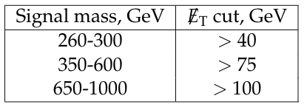
MET cut to be orthogonal to 2b2l2q
MET selection for us (and for 2b2l2q) was developed by both teams together to achieve the best limit for the bbZZ combination

Slide 76
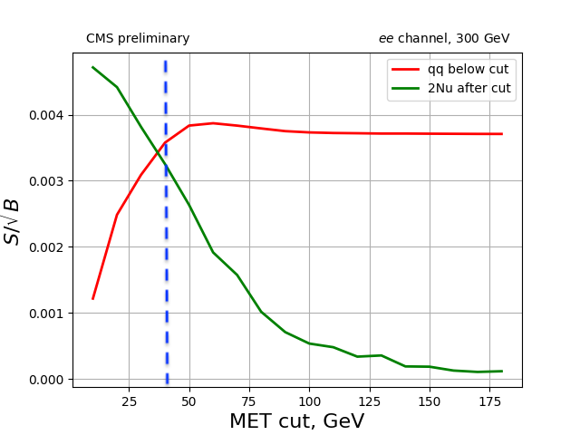
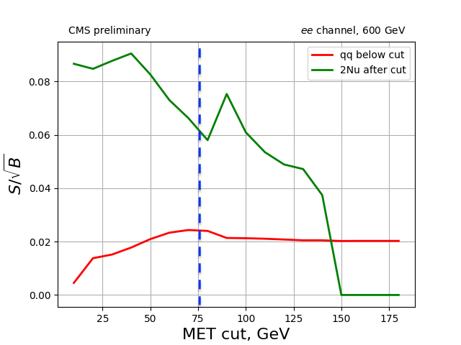
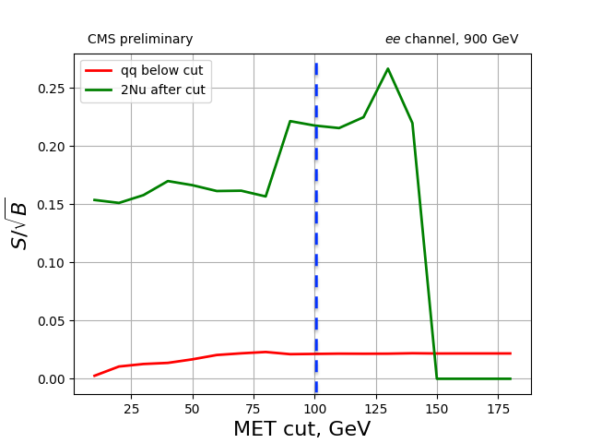
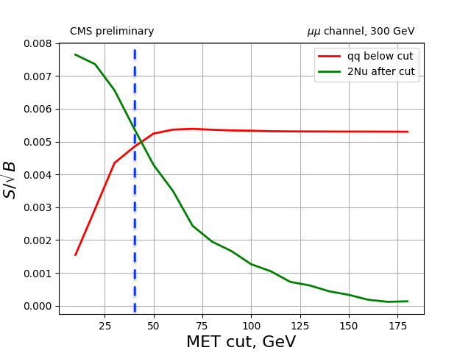
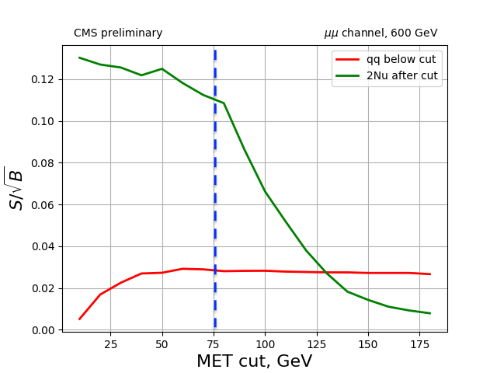
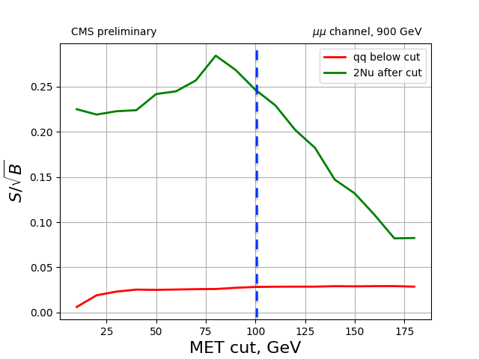
MET cut to be orthogonal to 2b2l2q, cont.

Slide 77
Correlations, ee, low

Slide 78
Correlations, ee, high

Slide 79
Variables, graviton, ee, low
Index ’1’ refers to H → bb decay and index ’0’ refers to H → ZZ decay.

Slide 80
Variables, graviton, ee, high
Index ’1’ refers to H → bb decay and index ’0’ refers to H → ZZ decay.

Slide 81
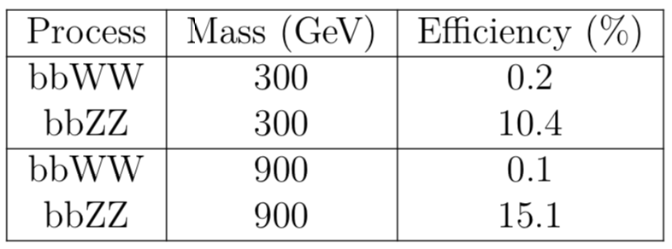
Event selection in the SR before BDT
Fraction of events surviving the candidate selection and kinematic requirements. Efficiencies are given for bbZZ and bbWW contributions in the SR and are normalised to the initial event counts before any selection is applied. A di-muon channel is presented. Numbers for the di-electron channel have the same trend but lower values, because in CMS efficiencies for electrons are lower than for muons.

Slide 82
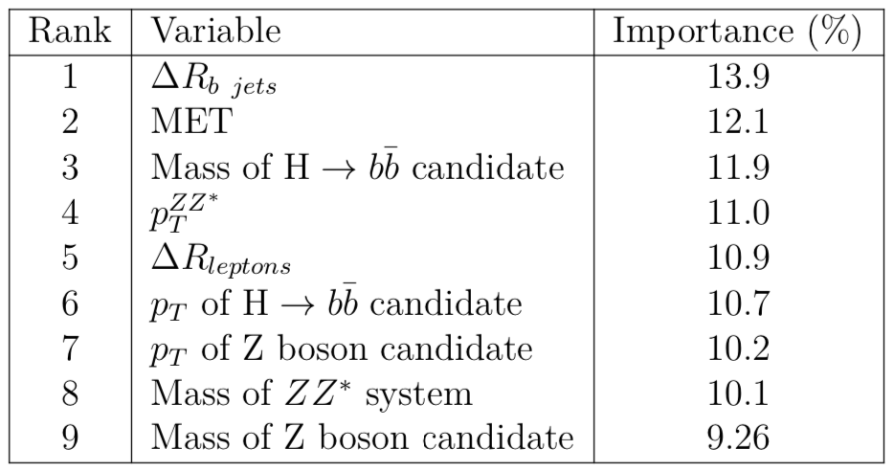
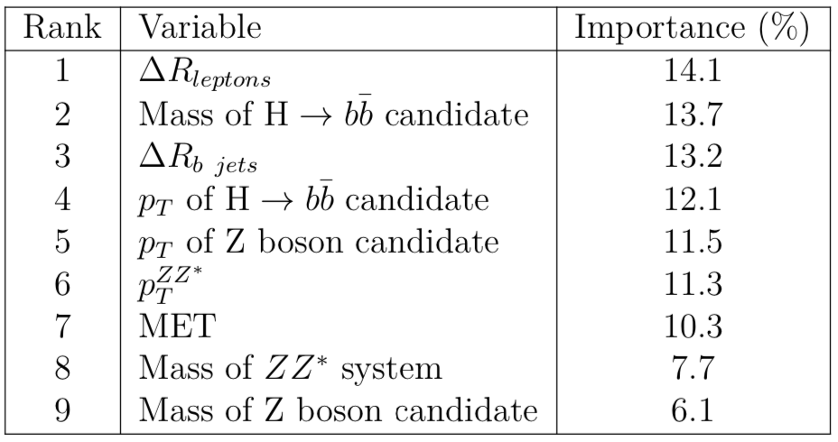
Importance of BDT variables, ee
Relative importance of the input ^{variables in the low mass} ^{BDT training.}
Relative importance of the input ^{variables in the high mass} ^{BDT training.}

Slide 83
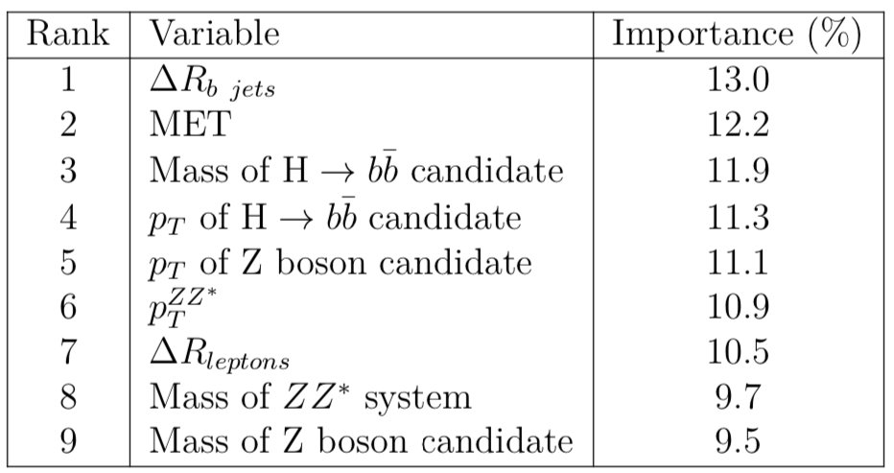
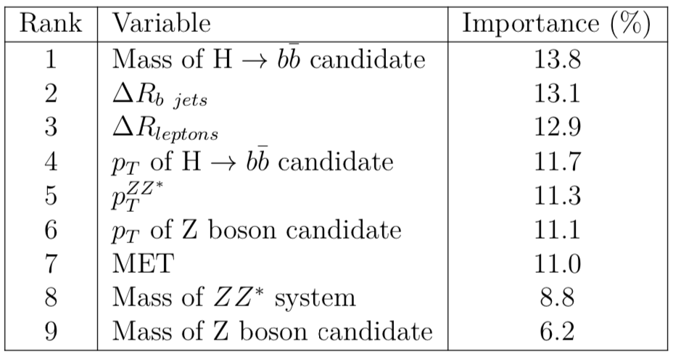
Importance of BDT variables, μμ
Relative importance of the input ^{variables in the low mass} ^{BDT training.}
Relative importance of the input ^{variables in the high mass} ^{BDT training.}

Slide 84
Low mass BDT
This is the region where backgrounds look very much signal-like, hard to get very high performance
electrons muons

Slide 85
High mass BDT
This is the region where signal is highly boosted, performance is noticeably higher
electrons muons

Slide 86
BDT distributions
m+m- e+e-
graviton (spin 2)
CRDY CRTT SR

Slide 87
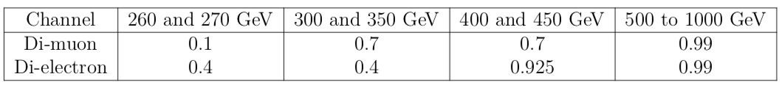
BDT optimization
• We are statistics dominated, so keep all uncertainties as lnN, otherwise it will take absurdly long to compute the result.
• Optimize each channel separately.
• Use as few cuts across the whole mass range as possible if it does not hurt the performance but helps to simplify the analysis and/or to avoid wasting weeks of computing time.

Slide 88
Cross check of BDTs and mass regions
Low mass BDT applied at high mass region - worse!
High mass BDT applied at 450 GeV mass region: good!
Apply high BDT all the way to the left until it is worse than low BDT. Answer - already at 400 GeV the limit with:
Original (low mass) BDT: r < 49.97
High mass BDT applied : r < 81.88

Slide 89
Electron channel
Cuts: Best Subopt.
0.4 0.4 0.4
Numbers represent cuts used in the analysis
0.4 0.925 0.925
0.99 0.99 0.99

Slide 90
Muon channel
0.1 0.1 0.7
Cuts: Best Subopt.
0.7 0.7 0.7
0.99 0.99 0.99

Slide 91

BDT efficiency
Efficiency of the BDT selection in two mass regions and for two channels: ee channel (top) and μμ channel (bottom). BDT selection at 300 ^{GeV} ^{is 0.4(ee) and 0.7(μμ)}

Slide 92

Expected event yield
Expected event yields and observed data counts in the SR, split by channel. 300 GeV graviton mass hypothesis. Signal is normalized to 1 pb cross section. BDT selection is 0.4 for the ee, and 0.7 for μμ.

Slide 93
Systematics: impacts

Slide 94


Leading systematic uncertainties
The effect of leading systematic uncertainties on the total event yield for main signal and background processes, ee channel, 300 GeV graviton mass hypothesis.
The effect of leading systematic uncertainties on the total event yield for main signal and background processes, μμ channel, 300 GeV graviton mass hypothesis.

Slide 95


Upper limits at α=1-CL

Slide 96

90% CL Upper limits
Upper limits at 90% CL to the signal s for a Poissonian process using the Feldman– Cousins method as a function of the expected background b and for number of observed events n from 0 to 10

Slide 97




CL_{S} limits
^{Example of evaluation of CLs} ^{from pseudoexperiments.}
The distribution of the test statistic 􏰾2 lnλ 􏰿 is shown in blue assuming the signal-plus-background hypothesis and in red assuming the background-only hypothesis.
The black line shows the value of the test statistic measured in data, and the shaded areas represent p_{s+b} ^{(blue) and p}_{b} ^{(red).}

Slide 98

CL_{S} limits for Higgs
Example of upper limit reported as Brazil plot in the context of the search for the Higgs boson at the LHC by the ATLAS experiment. The expected limit to the signal strength 􏰻μ=σ/σ_{SM} is shown as dashed line, surrounded by the green and yellow bands. The observed limit is shown as a solid line. All mass values corresponding to a limit below 􏰻μ=1 (dashed horizontal line) are excluded at the 95% confidence level.

Slide 99
Derivation of the expected limits
• Normalize signal samples to HH xsec of 1pb
• Use bbZZ (~0.0012) and bbWW(~0.0266) known BFs
• A fit of all regions simultaneously in order to extract the signal strength as well as the
normalization of DY and TT backgrounds
• Obtained value of ‘r’ is 95% CL upper limit on σ(pp ➔ X ➔ HH) in pb

Slide 100

95 % CL upper limits
graviton(spin 2)
http://cds.cern.ch/record/2648796?ln=en

Slide 101

95 % CL upper limits
radion (spin 0)
http://cds.cern.ch/record/2648796?ln=en

Slide 102


Combination of HH channels
Combination of HH channels using 2016 data. Expected (dashed) and observed (solid line) 95% CL exclusion limits are shown. The results describe the production cross section of a narrow width spin 0 (left) and spin 2 (right) resonance decaying into a pair of SM Higgs bosons.

Slide 103
Particles traversing CMS
Muon: passing through CMS, bending in the field (both ways, depending on when it is inside or outside of the solenoid) leaving hits in the Tracker layers and the muon chambers before escaping completely
Electron: Bending in the magnetic field, leaving hits in the tracker layers and being “stopped” by the electromagnetic calorimeter
Charged hadron: Bends in the magnetic field and leaves signals in the tracker layers; passes through the electromagnetic calorimeter leaving essentially no signal, and is “stopped” by the hadron calorimeter
Neutral hadron: Does not bend in the magnetic field and does not leave any signal in the tracker layers; passes through the electromagnetic calorimeter leaving essentially no signal, and is “stopped” by the hadron calorimeter
Photon: passes through the tracker without bending in the magnetic field or leaving hits, is “stopped” by the electromagnetic calorimeter

Slide 104



Notes:
Muon: passing through CMS, bending in the field (both ways, depending on when it is inside or outside of the solenoid) leaving hits in the Tracker layers and the muon chambers before escaping completely

Slide 105



Notes:
Electron: Bending in the magnetic field, leaving hits in the tracker layers and being “stopped” by the electromagnetic calorimeter

Slide 106



Notes:
Charged hadron: Bends in the magnetic field and leaves signals in the tracker layers; passes through the electromagnetic calorimeter leaving essentially no signal, and is “stopped” by the hadron calorimeter

Slide 107


Notes:
Neutral hadron: Does not bend in the magnetic field and does not leave any signal in the tracker layers; passes through the electromagnetic calorimeter leaving essentially no signal, and is “stopped” by the hadron calorimeter

Slide 108



Notes:
Photon: passes through the tracker without bending in the magnetic field or leaving hits, is “stopped” by the electromagnetic calorimeter

Slide 109


